Slide 2
The Resurrection of Christ

Slide 3
Evidence for
The Resurrection of Christ

Slide 4
The Resurrection is important

Slide 5
The Resurrection is important
  Christianity is based on an historical event

Slide 6
The Resurrection is important
  Christianity is based on an historical event
    The resurrection of Jesus Christ from the dead

Slide 7
The Resurrection is important
  Christianity is based on an historical event
    The resurrection of Jesus Christ from the dead
1 Corinthians 15:17-19
And if Christ is not risen, your faith is futile; you are still in your sins! Then also those who have fallen asleep in Christ have perished. If in this life only we have hope in Christ, we are of all men the most pitiable.

Slide 8
The Resurrection is important
  Christianity is based on an historical event
    The resurrection of Jesus Christ from the dead
1 Corinthians 15:17-19
And if Christ is not risen, your faith is futile; you are still in your sins! Then also those who have fallen asleep in Christ have perished. If in this life only we have hope in Christ, we are of all men the most pitiable.
doesn’t work!

Slide 9
The Resurrection is important
  Christianity is based on an historical event
    The resurrection of Jesus Christ from the dead
1 Corinthians 15:17-19
And if Christ is not risen, your faith is futile; you are still in your sins! Then also those who have fallen asleep in Christ have perished. If in this life only we have hope in Christ, we are of all men the most pitiable.
  Christianity and the resurrection of Jesus stand or fall together!
doesn’t work!

Slide 10
The Resurrection is unique

Slide 11
The Resurrection is unique
  No other religion has historical evidence to support it’s supernatural claims

Slide 12
The Resurrection is unique
  No other religion has historical evidence to support it’s supernatural claims
    Hindu, Islam, Mormonism

Slide 13
The Resurrection is unique
  No other religion has historical evidence to support it’s supernatural claims
    Hindu, Islam, Mormonism
      When tested they all fall short of the facts

Slide 14
The Resurrection is unique
  No other religion has historical evidence to support it’s supernatural claims
    Hindu, Islam, Mormonism
      When tested they all fall short of the facts
        Hindu writings say that the earth has a mountain in the middle of the continents that is 252,000 miles high

Slide 15
The Resurrection is unique
  No other religion has historical evidence to support it’s supernatural claims
    Hindu, Islam, Mormonism
      When tested they all fall short of the facts
        Hindu writings say that the earth has a mountain in the middle of the continents that is 252,000 miles high
          The moon is only 238,900 miles high

Slide 16
The Resurrection is unique
  No other religion has historical evidence to support it’s supernatural claims
    Hindu, Islam, Mormonism
      When tested they all fall short of the facts
        Hindu writings say that the earth has a mountain in the middle of the continents that is 252,000 miles high
          The moon is only 238,900 miles high
          The diameter of the Earth is 8,000 miles

Slide 17
        The Koran teaches that the Sun sets on the Earth in a pool of mud

Slide 18
        The Koran teaches that the Sun sets on the Earth in a pool of mud
        The Book of Mormon teaches that Native Americans are primarily descended from Jews

Slide 19
        The Koran teaches that the Sun sets on the Earth in a pool of mud
        The Book of Mormon teaches that Native Americans are primarily descended from Jews
          DNA has proven this wrong

Slide 20
        The Koran teaches that the Sun sets on the Earth in a pool of mud
        The Book of Mormon teaches that Native Americans are primarily descended from Jews
          DNA has proven this wrong
        Christianity’s major historical claim is the resurrection of Jesus

Slide 21
        The Koran teaches that the Sun sets on the Earth in a pool of mud
        The Book of Mormon teaches that Native Americans are primarily descended from Jews
          DNA has proven this wrong
        Christianity’s major historical claim is the resurrection of Jesus
          It is historically supported!

Slide 22
To show that Jesus is alive, we only need to look at 5 historical facts

Slide 23
To show that Jesus is alive, we only need to look at 5 historical facts
    #1 – A Death By Crucifixion

Slide 24
To show that Jesus is alive, we only need to look at 5 historical facts
    #1 – A Death By Crucifixion
    #2 – Ladies find the tomb empty

Slide 25
To show that Jesus is alive, we only need to look at 5 historical facts
    #1 – A Death By Crucifixion
    #2 – Ladies find the tomb empty
    #3 – Independent appearances of Jesus alive after death.

Slide 26
To show that Jesus is alive, we only need to look at 5 historical facts
    #1 – A Death By Crucifixion
    #2 – Ladies find the tomb empty
    #3 – Independent appearances of Jesus alive after death.
    #4 – Violence endured by the apostles

Slide 27
To show that Jesus is alive, we only need to look at 5 historical facts
    #1 – A Death By Crucifixion
    #2 – Ladies find the tomb empty
    #3 – Independent appearances of Jesus alive after death.
    #4 – Violence endured by the apostles
    #5 – Enemies of Christ converted

Slide 28
To show that Jesus is alive, we only need to look at 5 historical facts
    #1 – A Death By Crucifixion
    #2 – Ladies find the tomb empty
    #3 – Independent appearances of Jesus alive after death.
    #4 – Violence endured by the apostles
    #5 – Enemies of Christ converted
    These 5 fact are NOT controversial. Historians agree!

Slide 29
To show that Jesus is alive, we only need to look at 5 historical facts
    #1 – A Death By Crucifixion
    #2 – Ladies find the tomb empty
    #3 – Independent appearances of Jesus alive after death.
    #4 – Violence endured by the apostles
    #5 – Enemies of Christ converted
    These 5 fact are NOT controversial. Historians agree!
A

Slide 30
To show that Jesus is alive, we only need to look at 5 historical facts
    #1 – A Death By Crucifixion
    #2 – Ladies find the tomb empty
    #3 – Independent appearances of Jesus alive after death.
    #4 – Violence endured by the apostles
    #5 – Enemies of Christ converted
    These 5 fact are NOT controversial. Historians agree!
AL

Slide 31
To show that Jesus is alive, we only need to look at 5 historical facts
    #1 – A Death By Crucifixion
    #2 – Ladies find the tomb empty
    #3 – Independent appearances of Jesus alive after death.
    #4 – Violence endured by the apostles
    #5 – Enemies of Christ converted
    These 5 fact are NOT controversial. Historians agree!
ALI

Slide 32
To show that Jesus is alive, we only need to look at 5 historical facts
    #1 – A Death By Crucifixion
    #2 – Ladies find the tomb empty
    #3 – Independent appearances of Jesus alive after death.
    #4 – Violence endured by the apostles
    #5 – Enemies of Christ converted
    These 5 fact are NOT controversial. Historians agree!
ALIV

Slide 33
To show that Jesus is alive, we only need to look at 5 historical facts
    #1 – A Death By Crucifixion
    #2 – Ladies find the tomb empty
    #3 – Independent appearances of Jesus alive after death.
    #4 – Violence endured by the apostles
    #5 – Enemies of Christ converted
    These 5 fact are NOT controversial. Historians agree!
ALIVE

Slide 34
#1 – A death by crucifixion
Notes:
It can be considered a well established fact of history that Jesus really was crucified under Pontius Pilate and really died on the cross

Slide 35
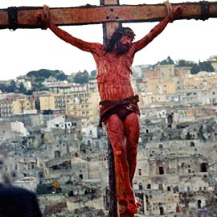
#1 – A death by crucifixion
Notes:
It can be considered a well established fact of history that Jesus really was crucified under Pontius Pilate and really died on the cross

Slide 36
To understand the evidence for the resurrection we need to look at the crucifixion

Slide 37
To understand the evidence for the resurrection we need to look at the crucifixion
  What happened to Jesus?

Slide 38
To understand the evidence for the resurrection we need to look at the crucifixion
  What happened to Jesus?
    Tortures

Slide 39
To understand the evidence for the resurrection we need to look at the crucifixion
  What happened to Jesus?
    Tortures
      Roman beating

Slide 40
To understand the evidence for the resurrection we need to look at the crucifixion
  What happened to Jesus?
    Tortures
      Roman beating
        Weapon – Flagrum (Flagellum)

Slide 41
To understand the evidence for the resurrection we need to look at the crucifixion
  What happened to Jesus?
    Tortures
      Roman beating
        Weapon – Flagrum (Flagellum)
          Whip of braided leather thongs with metal balls woven into them.

Slide 42
To understand the evidence for the resurrection we need to look at the crucifixion
  What happened to Jesus?
    Tortures
      Roman beating
        Weapon – Flagrum (Flagellum)
          Whip of braided leather thongs with metal balls woven into them.
          Causing deep bruises, breaking open with subsequent hits

Slide 43
To understand the evidence for the resurrection we need to look at the crucifixion
  What happened to Jesus?
    Tortures
      Roman beating
        Weapon – Flagrum (Flagellum)
          Whip of braided leather thongs with metal balls woven into them.
          Causing deep bruises, breaking open with subsequent hits
          Pieces of bone in the leather would tear and cut the flesh

Slide 44
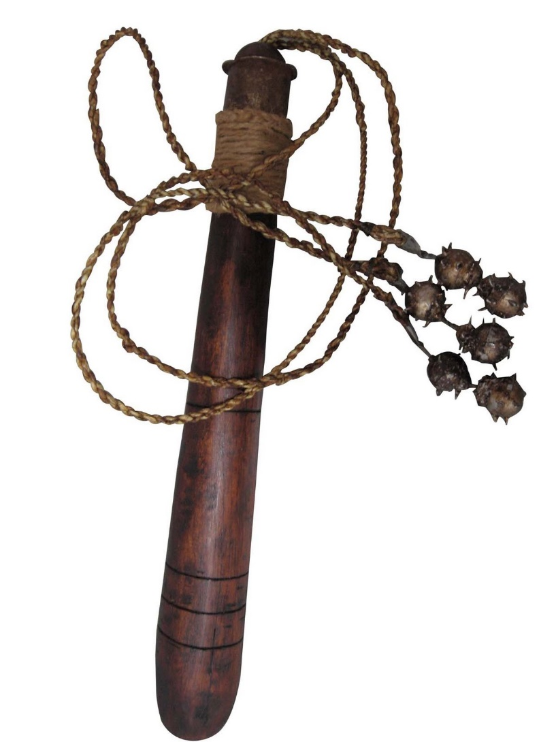

Slide 45
  Crucifixion

Slide 46
  Crucifixion
    Romans had perfected it

Slide 47
  Crucifixion
    Romans had perfected it
    To terrorize their enemies

Slide 48
  Crucifixion
    Romans had perfected it
    To terrorize their enemies
    Nails – crushing median nerve

Slide 49
  Crucifixion
    Romans had perfected it
    To terrorize their enemies
    Nails – crushing median nerve
      Nail in His heals

Slide 50
  Crucifixion
    Romans had perfected it
    To terrorize their enemies
    Nails – crushing median nerve
      Nail in His heals
      Dr. J. W. Hewitt in his Harvard Theological Review article “The Use of Nails in the Crucifixion”

Slide 51
  Crucifixion
    Romans had perfected it
    To terrorize their enemies
    Nails – crushing median nerve
      Nail in His heals
      Dr. J. W. Hewitt in his Harvard Theological Review article “The Use of Nails in the Crucifixion”
        “there is astonishingly little evidence that the feet of a crucified person were ever pierced by nails”

Slide 52
  Crucifixion
    Romans had perfected it
    To terrorize their enemies
    Nails – crushing median nerve
      Nail in His heals
      Dr. J. W. Hewitt in his Harvard Theological Review article “The Use of Nails in the Crucifixion”
        “there is astonishingly little evidence that the feet of a crucified person were ever pierced by nails”
          Implication – Bible is false and misleading

Slide 53
        But in June 1968 the Israeli Department of Antiquities and Museums discovered four cave tombs just north of Jerusalem.

Slide 54
        But in June 1968 the Israeli Department of Antiquities and Museums discovered four cave tombs just north of Jerusalem.
          In Ossuary 4 Tomb I

Slide 55
        But in June 1968 the Israeli Department of Antiquities and Museums discovered four cave tombs just north of Jerusalem.
          In Ossuary 4 Tomb I
            Adult male

Slide 56
        But in June 1968 the Israeli Department of Antiquities and Museums discovered four cave tombs just north of Jerusalem.
          In Ossuary 4 Tomb I
            Adult male
            7” spike through both heals

Slide 57
        But in June 1968 the Israeli Department of Antiquities and Museums discovered four cave tombs just north of Jerusalem.
          In Ossuary 4 Tomb I
            Adult male
            7” spike through both heals
            Broken shins

Slide 58
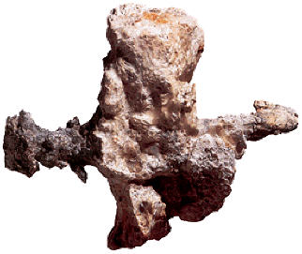

Slide 59
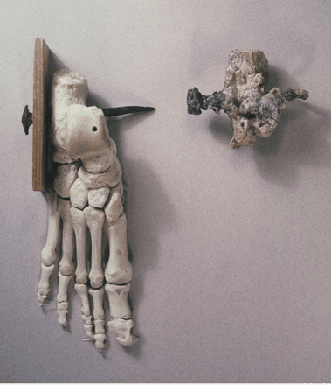

Slide 60
      Shoulders dislocated (6”) Ps 22

Slide 61
      Shoulders dislocated (6”) Ps 22
        How did crucifixion kill someone?

Slide 62
      Shoulders dislocated (6”) Ps 22
        How did crucifixion kill someone?
          They couldn’t exhale without standing up

Slide 63
      Shoulders dislocated (6”) Ps 22
        How did crucifixion kill someone?
          They couldn’t exhale without standing up
      “excruciating” – out of the cross

Slide 64
      Shoulders dislocated (6”) Ps 22
        How did crucifixion kill someone?
          They couldn’t exhale without standing up
      “excruciating” – out of the cross
    The Spear

Slide 65
      Shoulders dislocated (6”) Ps 22
        How did crucifixion kill someone?
          They couldn’t exhale without standing up
      “excruciating” – out of the cross
    The Spear
      Romans soldiers were trained killers

Slide 66
      Shoulders dislocated (6”) Ps 22
        How did crucifixion kill someone?
          They couldn’t exhale without standing up
      “excruciating” – out of the cross
    The Spear
      Romans soldiers were trained killers
        They knew when someone was dead…

Slide 67
      Shoulders dislocated (6”) Ps 22
        How did crucifixion kill someone?
          They couldn’t exhale without standing up
      “excruciating” – out of the cross
    The Spear
      Romans soldiers were trained killers
        They knew when someone was dead…
        And they knew how to guarantee that someone was dead

Slide 68
      Shoulders dislocated (6”) Ps 22
        How did crucifixion kill someone?
          They couldn’t exhale without standing up
      “excruciating” – out of the cross
    The Spear
      Romans soldiers were trained killers
        They knew when someone was dead…
        And they knew how to guarantee that someone was dead
          blood and water poured out

Slide 69
      Shoulders dislocated (6”) Ps 22
        How did crucifixion kill someone?
          They couldn’t exhale without standing up
      “excruciating” – out of the cross
    The Spear
      Romans soldiers were trained killers
        They knew when someone was dead…
        And they knew how to guarantee that someone was dead
          blood and water poured out
            Either the pericardium

Slide 70
      Shoulders dislocated (6”) Ps 22
        How did crucifixion kill someone?
          They couldn’t exhale without standing up
      “excruciating” – out of the cross
    The Spear
      Romans soldiers were trained killers
        They knew when someone was dead…
        And they knew how to guarantee that someone was dead
          blood and water poured out
            Either the pericardium
            Or the lungs

Slide 71
      Shoulders dislocated (6”) Ps 22
        How did crucifixion kill someone?
          They couldn’t exhale without standing up
      “excruciating” – out of the cross
    The Spear
      Romans soldiers were trained killers
        They knew when someone was dead…
        And they knew how to guarantee that someone was dead
          blood and water poured out
            Either the pericardium
            Or the lungs
        Jesus was definitely dead

Slide 72
  Burial

Slide 73
  Burial
    spices, 75 pounds (or more)

Slide 74
  Burial
    spices, 75 pounds (or more)
  Security measures by Romans

Slide 75
  Burial
    spices, 75 pounds (or more)
  Security measures by Romans
Matthew 27:62-66 (NKJV) On the next day, which followed the Day of Preparation, the chief priests and Pharisees gathered together to Pilate, saying, “Sir, we remember, while He was still alive, how that deceiver said, ‘After three days I will rise.’ Therefore command that the tomb be made secure until the third day, lest His disciples come by night and steal Him away, and say to the people, ‘He has risen from the dead.’ So the last deception will be worse than the first.” Pilate said to them, “You have a guard; go your way, make it as secure as you know how.” So they went and made the tomb secure, sealing the stone and setting the guard.

Slide 76
1- Solid rock tomb

Slide 77
1- Solid rock tomb
  No other way out

Slide 78
1- Solid rock tomb
  No other way out
2- Stone – 1 ½ - 2 tons

Slide 79
1- Solid rock tomb
  No other way out
2- Stone – 1 ½ - 2 tons
  Rolled down into place

Slide 80
1- Solid rock tomb
  No other way out
2- Stone – 1 ½ - 2 tons
  Rolled down into place
3- Seal

Slide 81
1- Solid rock tomb
  No other way out
2- Stone – 1 ½ - 2 tons
  Rolled down into place
3- Seal
  The seal was a soft, moldable substance, probably clay, that was imprinted with the Roman imperial seal and attached to the stone with a rope. Breaking the seal would incur the Empire’s wrath — if someone could get past the guards.

Slide 82
1- Solid rock tomb
  No other way out
2- Stone – 1 ½ - 2 tons
  Rolled down into place
3- Seal
  The seal was a soft, moldable substance, probably clay, that was imprinted with the Roman imperial seal and attached to the stone with a rope. Breaking the seal would incur the Empire’s wrath — if someone could get past the guards.
4- Roman guard 4-16 men

Slide 83
1- Solid rock tomb
  No other way out
2- Stone – 1 ½ - 2 tons
  Rolled down into place
3- Seal
  The seal was a soft, moldable substance, probably clay, that was imprinted with the Roman imperial seal and attached to the stone with a rope. Breaking the seal would incur the Empire’s wrath — if someone could get past the guards.
4- Roman guard 4-16 men
  Likely closer to 16

Slide 84
1- Solid rock tomb
  No other way out
2- Stone – 1 ½ - 2 tons
  Rolled down into place
3- Seal
  The seal was a soft, moldable substance, probably clay, that was imprinted with the Roman imperial seal and attached to the stone with a rope. Breaking the seal would incur the Empire’s wrath — if someone could get past the guards.
4- Roman guard 4-16 men
  Likely closer to 16
  Death penalty for sleeping on post

Slide 85
1- Solid rock tomb
  No other way out
2- Stone – 1 ½ - 2 tons
  Rolled down into place
3- Seal
  The seal was a soft, moldable substance, probably clay, that was imprinted with the Roman imperial seal and attached to the stone with a rope. Breaking the seal would incur the Empire’s wrath — if someone could get past the guards.
4- Roman guard 4-16 men
  Likely closer to 16
  Death penalty for sleeping on post
This all helps our case

Slide 86
Do we see this OUTSIDE the Bible?

Slide 87
Do we see this OUTSIDE the Bible?
  1st century, non-christian historians/sources

Slide 88
Do we see this OUTSIDE the Bible?
  1st century, non-christian historians/sources
    Josephus (37 AD-100 AD) Roman Historian

Slide 89
Do we see this OUTSIDE the Bible?
  1st century, non-christian historians/sources
    Josephus (37 AD-100 AD) Roman Historian
“at this time there was a wise man who was called Jesus. And his conduct was good, and he was known to be virtuous. And many people from among the Jews and the other nations became his disciples. Pilate condemned him to be crucified and to die. And those who had become his disciples did not abandon his discipleship. They reported that he had appeared to them after his crucifixion and that he was alive; accordingly, he was perhaps the Messiah concerning whom the prophets have recounted wonders.”

Slide 90
Do we see this OUTSIDE the Bible?
  1st century, non-christian historians/sources
    Josephus (37 AD-100 AD) Roman Historian
“at this time there was a wise man who was called Jesus. And his conduct was good, and he was known to be virtuous. And many people from among the Jews and the other nations became his disciples. Pilate condemned him to be crucified and to die. And those who had become his disciples did not abandon his discipleship. They reported that he had appeared to them after his crucifixion and that he was alive; accordingly, he was perhaps the Messiah concerning whom the prophets have recounted wonders.”
    Tacitus (55AD-120AD)

Slide 91
Do we see this OUTSIDE the Bible?
  1st century, non-christian historians/sources
    Josephus (37 AD-100 AD) Roman Historian
“at this time there was a wise man who was called Jesus. And his conduct was good, and he was known to be virtuous. And many people from among the Jews and the other nations became his disciples. Pilate condemned him to be crucified and to die. And those who had become his disciples did not abandon his discipleship. They reported that he had appeared to them after his crucifixion and that he was alive; accordingly, he was perhaps the Messiah concerning whom the prophets have recounted wonders.”
    Tacitus (55AD-120AD)
    Jewish Talmud – “stolen”

Slide 92
Do we see this OUTSIDE the Bible?
  1st century, non-christian historians/sources
    Josephus (37 AD-100 AD) Roman Historian
“at this time there was a wise man who was called Jesus. And his conduct was good, and he was known to be virtuous. And many people from among the Jews and the other nations became his disciples. Pilate condemned him to be crucified and to die. And those who had become his disciples did not abandon his discipleship. They reported that he had appeared to them after his crucifixion and that he was alive; accordingly, he was perhaps the Messiah concerning whom the prophets have recounted wonders.”
    Tacitus (55AD-120AD)
    Jewish Talmud – “stolen”
    Hostile sources!

Slide 93
    The crucifixion of Jesus really happened
Notes:
Apparent death theory
1 – it ignores the tortures and physical suffering
2- It makes Jesus a deceiver
3- it makes a half dead Jesus the inspiration of the radical change of life and full commitment of the disciples to a belief in their own resurrection based on His.

Slide 94
    The crucifixion of Jesus really happened
      It is firmly established and New Testament historians are convinced.
Notes:
Apparent death theory
1 – it ignores the tortures and physical suffering
2- It makes Jesus a deceiver
3- it makes a half dead Jesus the inspiration of the radical change of life and full commitment of the disciples to a belief in their own resurrection based on His.

Slide 95
    The crucifixion of Jesus really happened
      It is firmly established and New Testament historians are convinced.
        Every one agrees… every one.
Notes:
Apparent death theory
1 – it ignores the tortures and physical suffering
2- It makes Jesus a deceiver
3- it makes a half dead Jesus the inspiration of the radical change of life and full commitment of the disciples to a belief in their own resurrection based on His.

Slide 96
    The crucifixion of Jesus really happened
      It is firmly established and New Testament historians are convinced.
        Every one agrees… every one.
    John Mayer (the preeminent historical Jesus scholar today)
Notes:
Apparent death theory
1 – it ignores the tortures and physical suffering
2- It makes Jesus a deceiver
3- it makes a half dead Jesus the inspiration of the radical change of life and full commitment of the disciples to a belief in their own resurrection based on His.

Slide 97
    The crucifixion of Jesus really happened
      It is firmly established and New Testament historians are convinced.
        Every one agrees… every one.
    John Mayer (the preeminent historical Jesus scholar today)
  “For two obvious reasons practically no one today would deny that Jesus was executed by crucifixion. This central event is recorded or alluded to not only by the vast majority of New Testament authors but also by Josephus and Tacitus. Such an embarrassing event created a major obstacle to converting Jews and Gentiles alike that the church struggled to overcome.”
Notes:
Apparent death theory
1 – it ignores the tortures and physical suffering
2- It makes Jesus a deceiver
3- it makes a half dead Jesus the inspiration of the radical change of life and full commitment of the disciples to a belief in their own resurrection based on His.

Slide 98
    The crucifixion of Jesus really happened
      It is firmly established and New Testament historians are convinced.
        Every one agrees… every one.
    John Mayer (the preeminent historical Jesus scholar today)
  “For two obvious reasons practically no one today would deny that Jesus was executed by crucifixion. This central event is recorded or alluded to not only by the vast majority of New Testament authors but also by Josephus and Tacitus. Such an embarrassing event created a major obstacle to converting Jews and Gentiles alike that the church struggled to overcome.”
        Journal of Biblical Literature 1987
Notes:
Apparent death theory
1 – it ignores the tortures and physical suffering
2- It makes Jesus a deceiver
3- it makes a half dead Jesus the inspiration of the radical change of life and full commitment of the disciples to a belief in their own resurrection based on His.

Slide 99
#1 – A death by crucifixion
Let’s look at #2 – Ladies find the tomb empty
Notes:
ALL FOUR GOSPELS AGREE

Slide 100
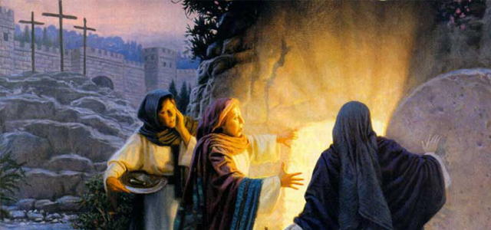
#1 – A death by crucifixion
Let’s look at #2 – Ladies find the tomb empty
Notes:
ALL FOUR GOSPELS AGREE

Slide 101
#1 – A death by crucifixion
Let’s look at #2 – Ladies find the tomb empty
Luke 24:1–12 (NKJV)
Now on the first day of the week, very early in the morning, they, and certain other women with them, came to the tomb bringing the spices which they had prepared. But they found the stone rolled away from the tomb. Then they went in and did not find the body of the Lord Jesus. And it happened, as they were greatly perplexed about this, that behold, two men stood by them in shining garments. Then, as they were afraid and bowed their faces to the earth, they said to them, “Why do you seek the living among the dead? He is not here, but is risen!

Slide 102
#1 – A death by crucifixion
Let’s look at #2 – Ladies find the tomb empty
Luke 24:1–12 (NKJV)
Remember how He spoke to you when He was still in Galilee, saying, ‘The Son of Man must be delivered into the hands of sinful men, and be crucified, and the third day rise again.’ ” And they remembered His words. Then they returned from the tomb and told all these things to the eleven and to all the rest. It was Mary Magdalene, Joanna, Mary the mother of James, and the other women with them, who told these things to the apostles. And their words seemed to them like idle tales, and they did not believe them.

Slide 103
#2 – Ladies find the tomb empty

Slide 104
#2 – Ladies find the tomb empty
  First to find tomb and first to see Jesus alive

Slide 105
#2 – Ladies find the tomb empty
  First to find tomb and first to see Jesus alive
  Unlikely witnesses

Slide 106
#2 – Ladies find the tomb empty
  First to find tomb and first to see Jesus alive
  Unlikely witnesses
    Hurt the credibility of the story

Slide 107
#2 – Ladies find the tomb empty
  First to find tomb and first to see Jesus alive
  Unlikely witnesses
    Hurt the credibility of the story
    They were mocked by contemporaries

Slide 108
#2 – Ladies find the tomb empty
  First to find tomb and first to see Jesus alive
  Unlikely witnesses
    Hurt the credibility of the story
    They were mocked by contemporaries
    The disciples didn’t believe them at first (Luke 24:11)

Slide 109
#2 – Ladies find the tomb empty
  First to find tomb and first to see Jesus alive
  Unlikely witnesses
    Hurt the credibility of the story
    They were mocked by contemporaries
    The disciples didn’t believe them at first (Luke 24:11)
      This strengthens the case for the historicity of it

Slide 110
#2 – Ladies find the tomb empty
  First to find tomb and first to see Jesus alive
  Unlikely witnesses
    Hurt the credibility of the story
    They were mocked by contemporaries
    The disciples didn’t believe them at first (Luke 24:11)
      This strengthens the case for the historicity of it
      A Jewish lie wouldn’t have started that way

Slide 111
#2 – Ladies find the tomb empty
  First to find tomb and first to see Jesus alive
  Unlikely witnesses
    Hurt the credibility of the story
    They were mocked by contemporaries
    The disciples didn’t believe them at first (Luke 24:11)
      This strengthens the case for the historicity of it
      A Jewish lie wouldn’t have started that way
      Embarrassing

Slide 112
#2 – Ladies find the tomb empty
  First to find tomb and first to see Jesus alive
  Unlikely witnesses
    Hurt the credibility of the story
    They were mocked by contemporaries
    The disciples didn’t believe them at first (Luke 24:11)
      This strengthens the case for the historicity of it
      A Jewish lie wouldn’t have started that way
      Embarrassing
        This is something historians look for

Slide 113
  #3 – Independent appearances of Jesus alive after death.

Slide 114
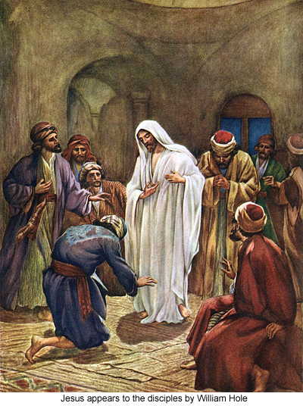
  #3 – Independent appearances of Jesus alive after death.

Slide 115
  #3 – Independent appearances of Jesus alive after death.
1 Corinthians 15:3–8 For I delivered to you first of all that which I also received: that Christ died for our sins according to the Scriptures, and that He was buried, and that He rose again the third day according to the Scriptures, and that He was seen by Cephas, then by the twelve. After that He was seen by over five hundred brethren at once, of whom the greater part remain to the present, but some have fallen asleep. After that He was seen by James, then by all the apostles. Then last of all He was seen by me also, as by one born out of due time.

Slide 116
  #3 – Independent appearances of Jesus alive after death.
1 Corinthians 15:3–8 For I delivered to you first of all that which I also received: that Christ died for our sins according to the Scriptures, and that He was buried, and that He rose again the third day according to the Scriptures, and that He was seen by Cephas, then by the twelve. After that He was seen by over five hundred brethren at once, of whom the greater part remain to the present, but some have fallen asleep. After that He was seen by James, then by all the apostles. Then last of all He was seen by me also, as by one born out of due time.
  This passage is safely dated to within 5 years after the crucifixion

Slide 117
  #3 – Independent appearances of Jesus alive after death.
    Many people were eye-witnesses of Jesus alive after death

Slide 118
  #3 – Independent appearances of Jesus alive after death.
    Many people were eye-witnesses of Jesus alive after death
    Let’s talk about a few of them

Slide 119
  #3 – Independent appearances of Jesus alive after death.
    Many people were eye-witnesses of Jesus alive after death
    Let’s talk about a few of them
      The women disciples (Matt 28:8-10)

Slide 120
  #3 – Independent appearances of Jesus alive after death.
    Many people were eye-witnesses of Jesus alive after death
    Let’s talk about a few of them
      The women disciples (Matt 28:8-10)
        Saw Him alive after finding the empty tomb

Slide 121
  #3 – Independent appearances of Jesus alive after death.
    Many people were eye-witnesses of Jesus alive after death
    Let’s talk about a few of them
      The women disciples (Matt 28:8-10)
        Saw Him alive after finding the empty tomb
        They held His feet and worshipped Him

Slide 122
  #3 – Independent appearances of Jesus alive after death.
    Many people were eye-witnesses of Jesus alive after death
    Let’s talk about a few of them
      The women disciples (Matt 28:8-10)
        Saw Him alive after finding the empty tomb
        They held His feet and worshipped Him
          A physical resurrection

Slide 123
    Ten of the apostles (Luke 24 & John 20)

Slide 124
    Ten of the apostles (Luke 24 & John 20)
Luke 24:36–43 Now as they said these things, Jesus Himself stood in the midst of them, and said to them, “Peace to you.” But they were terrified and frightened, and supposed they had seen a spirit. And He said to them, “Why are you troubled? And why do doubts arise in your hearts? Behold My hands and My feet, that it is I Myself. Handle Me and see, for a spirit does not have flesh and bones as you see I have.” When He had said this, He showed them His hands and His feet. But while they still did not believe for joy, and marveled, He said to them, “Have you any food here?” So they gave Him a piece of a broiled fish and some honeycomb. And He took it and ate in their presence.

Slide 125
      Jesus was physically resurrected

Slide 126
      Jesus was physically resurrected
        He let them touch Him

Slide 127
      Jesus was physically resurrected
        He let them touch Him
        He ate with them

Slide 128
      Jesus was physically resurrected
        He let them touch Him
        He ate with them
        What could this be other than a legitimate resurrection?

Slide 129
      Jesus was physically resurrected
        He let them touch Him
        He ate with them
        What could this be other than a legitimate resurrection?
      Thomas wasn’t there!

Slide 130
    Jesus appears to “doubting” Thomas

Slide 131
    Jesus appears to “doubting” Thomas
John 20:26–29 And after eight days His disciples were again inside, and Thomas with them. Jesus came, the doors being shut, and stood in the midst, and said, “Peace to you!” Then He said to Thomas, “Reach your finger here, and look at My hands; and reach your hand here, and put it into My side. Do not be unbelieving, but believing.” And Thomas answered and said to Him, “My Lord and my God!” Jesus said to him, “Thomas, because you have seen Me, you have believed. Blessed are those who have not seen and yet have believed.”

Slide 132
    500 at once!

Slide 133
    500 at once!
1 Corinthians 15:6 (NKJV) After that He was seen by over five hundred brethren at once, of whom the greater part remain to the present, but some have fallen asleep.

Slide 134
    500 at once!
1 Corinthians 15:6 (NKJV) After that He was seen by over five hundred brethren at once, of whom the greater part remain to the present, but some have fallen asleep.
      They could have tested it.

Slide 135
    500 at once!
1 Corinthians 15:6 (NKJV) After that He was seen by over five hundred brethren at once, of whom the greater part remain to the present, but some have fallen asleep.
      They could have tested it.
        Verifiable

Slide 136
    500 at once!
1 Corinthians 15:6 (NKJV) After that He was seen by over five hundred brethren at once, of whom the greater part remain to the present, but some have fallen asleep.
      They could have tested it.
        Verifiable
          Because they were still alive!

Slide 137
    500 at once!
1 Corinthians 15:6 (NKJV) After that He was seen by over five hundred brethren at once, of whom the greater part remain to the present, but some have fallen asleep.
      They could have tested it.
        Verifiable
          Because they were still alive!
          This is what historians look for

Slide 138
    500 at once!
1 Corinthians 15:6 (NKJV) After that He was seen by over five hundred brethren at once, of whom the greater part remain to the present, but some have fallen asleep.
      They could have tested it.
        Verifiable
          Because they were still alive!
          This is what historians look for
      It started in Jerusalem

Slide 139
    500 at once!
1 Corinthians 15:6 (NKJV) After that He was seen by over five hundred brethren at once, of whom the greater part remain to the present, but some have fallen asleep.
      They could have tested it.
        Verifiable
          Because they were still alive!
          This is what historians look for
      It started in Jerusalem
Acts 1:3 (NKJV) to whom He also presented Himself alive after His suffering by many infallible proofs, being seen by them during forty days and speaking of the things pertaining to the kingdom of God.

Slide 140
  #3 – Independent appearances of Jesus alive after death.
    Very few disagree with #3

Slide 141
  #3 – Independent appearances of Jesus alive after death.
    Very few disagree with #3
    The vast majority of historians believe all of these to be true based on normal ways of verifying an historical claim.

Slide 142
#4 Violence Endured By The Apostles

Slide 143
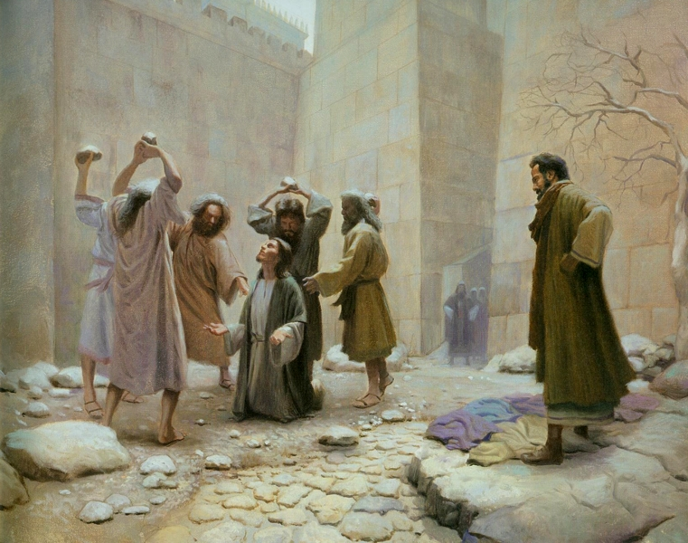
#4 Violence Endured By The Apostles

Slide 144
#4 Violence Endured By The Apostles
  When Jesus was alive and with them they didn’t have the courage and conviction to face death

Slide 145
#4 Violence Endured By The Apostles
  When Jesus was alive and with them they didn’t have the courage and conviction to face death
    They were “oh you of little faith”

Slide 146
#4 Violence Endured By The Apostles
  When Jesus was alive and with them they didn’t have the courage and conviction to face death
    They were “oh you of little faith”
    When He was crucified they scattered

Slide 147
#4 Violence Endured By The Apostles
  When Jesus was alive and with them they didn’t have the courage and conviction to face death
    They were “oh you of little faith”
    When He was crucified they scattered
    Peter denied knowing Jesus 3 times

Slide 148
#4 Violence Endured By The Apostles
  When Jesus was alive and with them they didn’t have the courage and conviction to face death
    They were “oh you of little faith”
    When He was crucified they scattered
    Peter denied knowing Jesus 3 times
    Afterward they were depressed, discouraged and terrified, hiding in the upper room with the door locked

Slide 149
#4 Violence Endured By The Apostles
  When Jesus was alive and with them they didn’t have the courage and conviction to face death
    They were “oh you of little faith”
    When He was crucified they scattered
    Peter denied knowing Jesus 3 times
    Afterward they were depressed, discouraged and terrified, hiding in the upper room with the door locked
    Something happened in their lives that changed them from cowering deserters to confident martyrs

Slide 150
#4 Violence Endured By The Apostles
  When Jesus was alive and with them they didn’t have the courage and conviction to face death
    They were “oh you of little faith”
    When He was crucified they scattered
    Peter denied knowing Jesus 3 times
    Afterward they were depressed, discouraged and terrified, hiding in the upper room with the door locked
    Something happened in their lives that changed them from cowering deserters to confident martyrs
  The apostles proclaimed the resurrection of Jesus despite severe persecution and personal sacrifice, even to the point of death

Slide 151
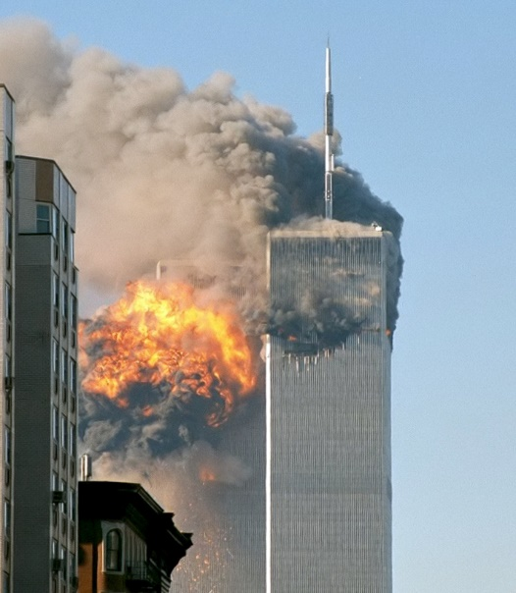
#4 Violence Endured By The Apostles
  But, people die for lies all the time
Notes:
“You will kill for your faith, I will die for mine”

Slide 152
#4 Violence Endured By The Apostles
  But, people die for lies all the time
                These people weren’t eye witnesses
Notes:
“You will kill for your faith, I will die for mine”

Slide 153
#4 Violence Endured By The Apostles
  When people knowingly lie it is always because of some perceived benefit

Slide 154
#4 Violence Endured By The Apostles
  When people knowingly lie it is always because of some perceived benefit
    Having been “eye-witnesses” of Jesus’ resurrection, they would have KNOWN if it was a lie

Slide 155
#4 Violence Endured By The Apostles
  When people knowingly lie it is always because of some perceived benefit
    Having been “eye-witnesses” of Jesus’ resurrection, they would have KNOWN if it was a lie
      All they gained by this lie was death

Slide 156
#4 Violence Endured By The Apostles
  When people knowingly lie it is always because of some perceived benefit
    Having been “eye-witnesses” of Jesus’ resurrection, they would have KNOWN if it was a lie
      All they gained by this lie was death
    Incredible deaths and persecution endured by the disciples

Slide 157
#4 Violence Endured By The Apostles
  When people knowingly lie it is always because of some perceived benefit
    Having been “eye-witnesses” of Jesus’ resurrection, they would have KNOWN if it was a lie
      All they gained by this lie was death
    Incredible deaths and persecution endured by the disciples
    They lost their lives (sources are the Bible, Josephus, and church fathers)

Slide 158
#4 Violence Endured By The Apostles
  When people knowingly lie it is always because of some perceived benefit
    Having been “eye-witnesses” of Jesus’ resurrection, they would have KNOWN if it was a lie
      All they gained by this lie was death
    Incredible deaths and persecution endured by the disciples
    They lost their lives (sources are the Bible, Josephus, and church fathers)
    Matthew – killed with sword for preaching in Ethiopia

Slide 159
#4 Violence Endured By The Apostles
  When people knowingly lie it is always because of some perceived benefit
    Having been “eye-witnesses” of Jesus’ resurrection, they would have KNOWN if it was a lie
      All they gained by this lie was death
    Incredible deaths and persecution endured by the disciples
    They lost their lives (sources are the Bible, Josephus, and church fathers)
    Matthew – killed with sword for preaching in Ethiopia
    Mark died in Alexandria (Northern Egypt) after being dragged through the city

Slide 160
#4 Violence Endured By The Apostles
    Luke was hung to death on an olive tree in Greece

Slide 161
#4 Violence Endured By The Apostles
    Luke was hung to death on an olive tree in Greece
    James beheaded in Jerusalem (Acts)

Slide 162
#4 Violence Endured By The Apostles
    Luke was hung to death on an olive tree in Greece
    James beheaded in Jerusalem (Acts)
    James (the less) thrown from the temple (wall) and then stoned to death

Slide 163
#4 Violence Endured By The Apostles
    Luke was hung to death on an olive tree in Greece
    James beheaded in Jerusalem (Acts)
    James (the less) thrown from the temple (wall) and then stoned to death
    Philip hung in Phrygia (Hyropolis)

Slide 164
#4 Violence Endured By The Apostles
    Luke was hung to death on an olive tree in Greece
    James beheaded in Jerusalem (Acts)
    James (the less) thrown from the temple (wall) and then stoned to death
    Philip hung in Phrygia (Hyropolis)
    Bartholemeu – flayed alive

Slide 165
#4 Violence Endured By The Apostles
    Luke was hung to death on an olive tree in Greece
    James beheaded in Jerusalem (Acts)
    James (the less) thrown from the temple (wall) and then stoned to death
    Philip hung in Phrygia (Hyropolis)
    Bartholemeu – flayed alive
    Andrew – bound to a cross with ropes and left to die of exposure

Slide 166
#4 Violence Endured By The Apostles
    Luke was hung to death on an olive tree in Greece
    James beheaded in Jerusalem (Acts)
    James (the less) thrown from the temple (wall) and then stoned to death
    Philip hung in Phrygia (Hyropolis)
    Bartholemeu – flayed alive
    Andrew – bound to a cross with ropes and left to die of exposure
    Jude shot to death with arrows

Slide 167
#4 Violence Endured By The Apostles
    Luke was hung to death on an olive tree in Greece
    James beheaded in Jerusalem (Acts)
    James (the less) thrown from the temple (wall) and then stoned to death
    Philip hung in Phrygia (Hyropolis)
    Bartholemeu – flayed alive
    Andrew – bound to a cross with ropes and left to die of exposure
    Jude shot to death with arrows
    Thomas run through with a lance in east india

Slide 168
#4 Violence Endured By The Apostles
    Luke was hung to death on an olive tree in Greece
    James beheaded in Jerusalem (Acts)
    James (the less) thrown from the temple (wall) and then stoned to death
    Philip hung in Phrygia (Hyropolis)
    Bartholemeu – flayed alive
    Andrew – bound to a cross with ropes and left to die of exposure
    Jude shot to death with arrows
    Thomas run through with a lance in east india
      Memorial to him there today

Slide 169
#4 Violence Endured By The Apostles
    Luke was hung to death on an olive tree in Greece
    James beheaded in Jerusalem (Acts)
    James (the less) thrown from the temple (wall) and then stoned to death
    Philip hung in Phrygia (Hyropolis)
    Bartholemeu – flayed alive
    Andrew – bound to a cross with ropes and left to die of exposure
    Jude shot to death with arrows
    Thomas run through with a lance in east india
      Memorial to him there today
    Matthias – stoned and then beheaded

Slide 170
#4 Violence Endured By The Apostles
    Barnabas stoned to death by Jews in Thessalonica

Slide 171
#4 Violence Endured By The Apostles
    Barnabas stoned to death by Jews in Thessalonica
    Paul finally beheaded in Rome

Slide 172
#4 Violence Endured By The Apostles
    Barnabas stoned to death by Jews in Thessalonica
    Paul finally beheaded in Rome
    Peter crucified (just as Jesus prophesied)

Slide 173
#4 Violence Endured By The Apostles
    Barnabas stoned to death by Jews in Thessalonica
    Paul finally beheaded in Rome
    Peter crucified (just as Jesus prophesied)
    NONE of them stopped preaching that they were witnesses of the resurrection

Slide 174
#4 Violence Endured By The Apostles
    Barnabas stoned to death by Jews in Thessalonica
    Paul finally beheaded in Rome
    Peter crucified (just as Jesus prophesied)
    NONE of them stopped preaching that they were witnesses of the resurrection
    There is no rational basis for believing they were knowingly lying

Slide 175
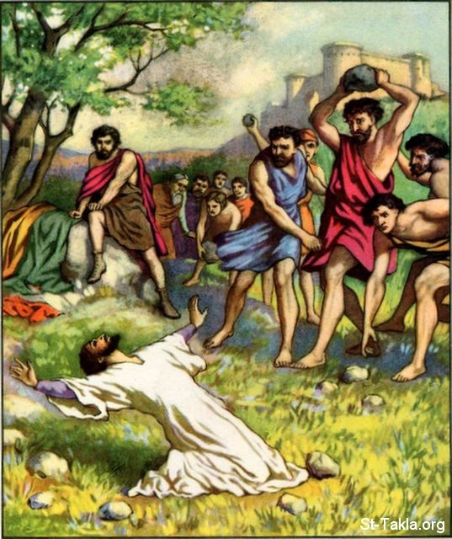
#5 – Enemies of Christ Converted

Slide 176
#5 – Enemies of Christ Converted
  James and Jude

Slide 177
#5 – Enemies of Christ Converted
  James and Jude
    Brothers of Jesus

Slide 178
#5 – Enemies of Christ Converted
  James and Jude
    Brothers of Jesus
    John 7:5 “for even His brothers did not believe Him”

Slide 179
#5 – Enemies of Christ Converted
  James and Jude
    Brothers of Jesus
    John 7:5 “for even His brothers did not believe Him”
    Before the crucifixion, when Jesus taught and worked His miracles they mocked Him

Slide 180
#5 – Enemies of Christ Converted
  James and Jude
    Brothers of Jesus
    John 7:5 “for even His brothers did not believe Him”
    Before the crucifixion, when Jesus taught and worked His miracles they mocked Him
  The were radical Christians after the resurrection

Slide 181
#5 – Enemies of Christ Converted
  James and Jude
    Brothers of Jesus
    John 7:5 “for even His brothers did not believe Him”
    Before the crucifixion, when Jesus taught and worked His miracles they mocked Him
  The were radical Christians after the resurrection
  What would it take to convince you that your brother is the Messiah

Slide 182
#5 – Enemies of Christ Converted
  Saul/Paul

Slide 183
#5 – Enemies of Christ Converted
  Saul/Paul
    The most impressive conversion of all

Slide 184
#5 – Enemies of Christ Converted
  Saul/Paul
    The most impressive conversion of all
    Saul was a persecutor of the church

Slide 185
#5 – Enemies of Christ Converted
  Saul/Paul
    The most impressive conversion of all
    Saul was a persecutor of the church
      He went town to town to persecute Christians

Slide 186
#5 – Enemies of Christ Converted
  Saul/Paul
    The most impressive conversion of all
    Saul was a persecutor of the church
      He went town to town to persecute Christians
      He didn’t claim a change of heart, he claimed an experience of seeing the risen Christ

Slide 187
#5 – Enemies of Christ Converted
  Saul/Paul
    The most impressive conversion of all
    Saul was a persecutor of the church
      He went town to town to persecute Christians
      He didn’t claim a change of heart, he claimed an experience of seeing the risen Christ
      I love that Jesus makes His enemies into His friends

Slide 188
#5 – Enemies of Christ Converted
  Saul/Paul
    The most impressive conversion of all
    Saul was a persecutor of the church
      He went town to town to persecute Christians
      He didn’t claim a change of heart, he claimed an experience of seeing the risen Christ
      I love that Jesus makes His enemies into His friends
  The resurrection of Christ is the most reasonable way to account for these various facts of history

Slide 189
#5 – Enemies of Christ Converted
  Saul/Paul
    The most impressive conversion of all
    Saul was a persecutor of the church
      He went town to town to persecute Christians
      He didn’t claim a change of heart, he claimed an experience of seeing the risen Christ
      I love that Jesus makes His enemies into His friends
  The resurrection of Christ is the most reasonable way to account for these various facts of history
    There is NO other rational explanation

Slide 191
  #1 – A Death By Crucifixion
Notes:
Swoon – refuted by #1 (spear, 3 days) #3 (assension) #4 (inspiring?)

Slide 192
  #1 – A Death By Crucifixion
  #2 – Ladies find the tomb empty
Notes:
Swoon – refuted by #1 (spear, 3 days) #3 (assension) #4 (inspiring?)

Slide 193
  #1 – A Death By Crucifixion
  #2 – Ladies find the tomb empty
  #3 – Independent appearances of Jesus alive
  after death.
Notes:
Swoon – refuted by #1 (spear, 3 days) #3 (assension) #4 (inspiring?)

Slide 194
  #1 – A Death By Crucifixion
  #2 – Ladies find the tomb empty
  #3 – Independent appearances of Jesus alive
  after death.
  #4 – Violence endured by the apostles
Notes:
Swoon – refuted by #1 (spear, 3 days) #3 (assension) #4 (inspiring?)

Slide 195
  #1 – A Death By Crucifixion
  #2 – Ladies find the tomb empty
  #3 – Independent appearances of Jesus alive
  after death.
  #4 – Violence endured by the apostles
  #5 – Enemies of Christ converted
Notes:
Swoon – refuted by #1 (spear, 3 days) #3 (assension) #4 (inspiring?)

Slide 196
  #1 – A Death By Crucifixion
  #2 – Ladies find the tomb empty
  #3 – Independent appearances of Jesus alive
  after death.
  #4 – Violence endured by the apostles
  #5 – Enemies of Christ converted
7 Alternate Explanations
Notes:
Swoon – refuted by #1 (spear, 3 days) #3 (assension) #4 (inspiring?)

Slide 197
  #1 – A Death By Crucifixion
  #2 – Ladies find the tomb empty
  #3 – Independent appearances of Jesus alive
  after death.
  #4 – Violence endured by the apostles
  #5 – Enemies of Christ converted
7 Alternate Explanations
The Swoon Theory
Notes:
Swoon – refuted by #1 (spear, 3 days) #3 (assension) #4 (inspiring?)

Slide 198
  #1 – A Death By Crucifixion
  #2 – Ladies find the tomb empty
  #3 – Independent appearances of Jesus alive
  after death.
  #4 – Violence endured by the apostles
  #5 – Enemies of Christ converted
7 Alternate Explanations
The Swoon Theory
Twin Theory
Notes:
Swoon – refuted by #1 (spear, 3 days) #3 (assension) #4 (inspiring?)

Slide 199
  #1 – A Death By Crucifixion
  #2 – Ladies find the tomb empty
  #3 – Independent appearances of Jesus alive
  after death.
  #4 – Violence endured by the apostles
  #5 – Enemies of Christ converted
7 Alternate Explanations
The Swoon Theory
Twin Theory
Mass Hallucination Theory
Notes:
Swoon – refuted by #1 (spear, 3 days) #3 (assension) #4 (inspiring?)

Slide 200
  #1 – A Death By Crucifixion
  #2 – Ladies find the tomb empty
  #3 – Independent appearances of Jesus alive
  after death.
  #4 – Violence endured by the apostles
  #5 – Enemies of Christ converted
7 Alternate Explanations
The Swoon Theory
Twin Theory
Mass Hallucination Theory
Spiritual Resurrection Theory
Notes:
Swoon – refuted by #1 (spear, 3 days) #3 (assension) #4 (inspiring?)

Slide 201
  #1 – A Death By Crucifixion
  #2 – Ladies find the tomb empty
  #3 – Independent appearances of Jesus alive
  after death.
  #4 – Violence endured by the apostles
  #5 – Enemies of Christ converted
7 Alternate Explanations
The Swoon Theory
Twin Theory
Mass Hallucination Theory
Spiritual Resurrection Theory
Wrong Tomb Theory
Notes:
Swoon – refuted by #1 (spear, 3 days) #3 (assension) #4 (inspiring?)

Slide 202
  #1 – A Death By Crucifixion
  #2 – Ladies find the tomb empty
  #3 – Independent appearances of Jesus alive
  after death.
  #4 – Violence endured by the apostles
  #5 – Enemies of Christ converted
7 Alternate Explanations
The Swoon Theory
Twin Theory
Mass Hallucination Theory
Spiritual Resurrection Theory
Wrong Tomb Theory
Missing Body Theory
Notes:
Swoon – refuted by #1 (spear, 3 days) #3 (assension) #4 (inspiring?)

Slide 203
  #1 – A Death By Crucifixion
  #2 – Ladies find the tomb empty
  #3 – Independent appearances of Jesus alive
  after death.
  #4 – Violence endured by the apostles
  #5 – Enemies of Christ converted
7 Alternate Explanations
The Swoon Theory
Twin Theory
Mass Hallucination Theory
Spiritual Resurrection Theory
Wrong Tomb Theory
Missing Body Theory
Conspiracy Theory
Notes:
Swoon – refuted by #1 (spear, 3 days) #3 (assension) #4 (inspiring?)

Slide 204
  #1 – A Death By Crucifixion
  #2 – Ladies find the tomb empty
  #3 – Independent appearances of Jesus alive
  after death.
  #4 – Violence endured by the apostles
  #5 – Enemies of Christ converted
7 Alternate Explanations
The Swoon Theory
Twin Theory
Mass Hallucination Theory
Spiritual Resurrection Theory
Wrong Tomb Theory
Missing Body Theory
Conspiracy Theory
Notes:
Swoon – refuted by #1 (spear, 3 days) #3 (assension) #4 (inspiring?)

Slide 205
  #1 – A Death By Crucifixion
  #2 – Ladies find the tomb empty
  #3 – Independent appearances of Jesus alive
  after death.
  #4 – Violence endured by the apostles
  #5 – Enemies of Christ converted
7 Alternate Explanations
The Swoon Theory
Twin Theory
Mass Hallucination Theory
Spiritual Resurrection Theory
Wrong Tomb Theory
Missing Body Theory
Conspiracy Theory
Notes:
Twin Theory – Refuted by #3 (wounds seen, touched) #4 (apostles traveled 3 years, they knew Jesus), #5 (his BROTHERS converted)

Slide 206
  #1 – A Death By Crucifixion
  #2 – Ladies find the tomb empty
  #3 – Independent appearances of Jesus alive
  after death.
  #4 – Violence endured by the apostles
  #5 – Enemies of Christ converted
7 Alternate Explanations
The Swoon Theory
Twin Theory
Mass Hallucination Theory
Spiritual Resurrection Theory
Wrong Tomb Theory
Missing Body Theory
Conspiracy Theory
Notes:
Mass Hallucination Theory (popular today) – refuted by #3 (INDEPENDENT - not a one time event) (also, physical, not just visual)
Also, refuted by reality – crowds can use drugs and all hallucinate, but they don’t see the same thing. This would, itself, be a miracle… (500 at once) only, one that doesn’t fit the rest of the evidence

Slide 207
  #1 – A Death By Crucifixion
  #2 – Ladies find the tomb empty
  #3 – Independent appearances of Jesus alive
  after death.
  #4 – Violence endured by the apostles
  #5 – Enemies of Christ converted
7 Alternate Explanations
The Swoon Theory
Twin Theory
Mass Hallucination Theory
Spiritual Resurrection Theory
Wrong Tomb Theory
Missing Body Theory
Conspiracy Theory
Notes:
Spiritual Resurrection – Refuted by #2 (empty tomb = body raised), #3 (eating, touching), #4 (violence was because of physical res claims, not spiritual) – the hope was in a physical res (1 Cor 15)
Also, vocab – the word NEVER meant that

Slide 208
  #1 – A Death By Crucifixion
  #2 – Ladies find the tomb empty
  #3 – Independent appearances of Jesus alive
  after death.
  #4 – Violence endured by the apostles
  #5 – Enemies of Christ converted
7 Alternate Explanations
The Swoon Theory
Twin Theory
Mass Hallucination Theory
Spiritual Resurrection Theory
Wrong Tomb Theory
Missing Body Theory
Conspiracy Theory
Notes:
Wrong Tomb – Refuted by #1 (desciption of tomb is given), #3, #4, #5 (APPEARANCES, not just an empty tomb, convinced them)
They NEVER brought out the body

Slide 209
  #1 – A Death By Crucifixion
  #2 – Ladies find the tomb empty
  #3 – Independent appearances of Jesus alive
  after death.
  #4 – Violence endured by the apostles
  #5 – Enemies of Christ converted
7 Alternate Explanations
The Swoon Theory
Twin Theory
Mass Hallucination Theory
Spiritual Resurrection Theory
Wrong Tomb Theory
Missing Body Theory
Conspiracy Theory
Notes:
Missing Body – Refuted by #3, #4, #5, - appearances

Slide 210
  #1 – A Death By Crucifixion
  #2 – Ladies find the tomb empty
  #3 – Independent appearances of Jesus alive
  after death.
  #4 – Violence endured by the apostles
  #5 – Enemies of Christ converted
7 Alternate Explanations
The Swoon Theory
Twin Theory
Mass Hallucination Theory
Spiritual Resurrection Theory
Wrong Tomb Theory
Missing Body Theory
Conspiracy Theory
Notes:
Conspiracy Theory – THIS is the oldest and the only one that has a historical basis
“The disciples stole the body”
Refuted by #2 (ladies first), #3 (MASSIVE numbers of people), #4 (their character was fear and quiting, not conspiracy, NO motive), #5 never would have happened

Slide 211
  #1 – A Death By Crucifixion
  #2 – Ladies find the tomb empty
  #3 – Independent appearances of Jesus alive
  after death.
  #4 – Violence endured by the apostles
  #5 – Enemies of Christ converted
One rational explanation
Notes:
Conspiracy Theory – THIS is the oldest and the only one that has a historical basis
“The disciples stole the body”
Refuted by #2 (ladies first), #3 (MASSIVE numbers of people), #4 (their character was fear and quiting, not conspiracy, NO motive), #5 never would have happened

Slide 212
  #1 – A Death By Crucifixion
  #2 – Ladies find the tomb empty
  #3 – Independent appearances of Jesus alive
  after death.
  #4 – Violence endured by the apostles
  #5 – Enemies of Christ converted
One rational explanation
Jesus is ALIVE
Notes:
Conspiracy Theory – THIS is the oldest and the only one that has a historical basis
“The disciples stole the body”
Refuted by #2 (ladies first), #3 (MASSIVE numbers of people), #4 (their character was fear and quiting, not conspiracy, NO motive), #5 never would have happened

Slide 213
    There are many other facts that support the resurrection which we don’t have time to cover

Slide 214
    There are many other facts that support the resurrection which we don’t have time to cover
      The prophecies that Christ fulfilled

Slide 215
    There are many other facts that support the resurrection which we don’t have time to cover
      The prophecies that Christ fulfilled
      The miraculous rise of Christianity

Slide 216
    There are many other facts that support the resurrection which we don’t have time to cover
      The prophecies that Christ fulfilled
      The miraculous rise of Christianity
      The influence of Jesus after His death

Slide 217
    There are many other facts that support the resurrection which we don’t have time to cover
      The prophecies that Christ fulfilled
      The miraculous rise of Christianity
      The influence of Jesus after His death
      The countless people who still claim He is alive

Slide 218
    There are many other facts that support the resurrection which we don’t have time to cover
      The prophecies that Christ fulfilled
      The miraculous rise of Christianity
      The influence of Jesus after His death
      The countless people who still claim He is alive
      The evidence of their changed lives which they credit to the living Jesus

Slide 219
What reason could anyone have for not believing?

Slide 220
What reason could anyone have for not believing?
  They decide, ahead of time, that God can’t do that

Slide 221
What reason could anyone have for not believing?
  They decide, ahead of time, that God can’t do that
    No evidence would convince this person

Slide 222
What reason could anyone have for not believing?
  They decide, ahead of time, that God can’t do that
    No evidence would convince this person
    Duck-billed Platypus

Slide 223
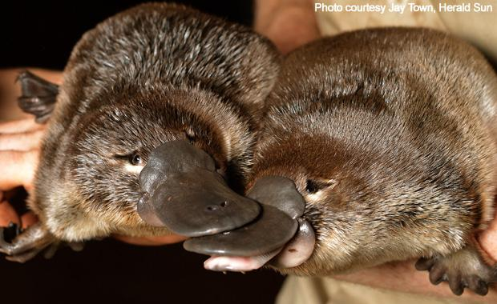
Mike Winger
  I have studied the resurrection and found the evidence to be solid
What reason could anyone have for not believing?
  They decide, ahead of time, that God can’t do that
    No evidence would convince this person
    Duck-billed Platypus
      Discovered in 1798
        A pelt and sketch were sent to England but were doubted
        Even upon seeing a live specimen some still didn’t believe
Notes:
Duck-billed Platypus Discovered in 1798 -- A pelt and sketch were sent to England but were doubted
Even upon seeing a live specimen some still didn’t believe

Slide 224
Evidence for
The Resurrection of Christ
A.L.I.V.E.

