Slide 2
?

Slide 3
?
  How could ANY book prove
  it is from God?

Slide 4
  Isaiah 46:9-10 (NKJV)
  Remember the former things of old, For I am God, and there is no other; I am God, and there is none like Me, declaring the end from the beginning, and from ancient times things that are not yet done, saying, ‘My counsel shall stand, And I will do all My pleasure,’

Slide 5
Prophecy

Slide 6
  It proves that the message is from God

Slide 7
  It proves that the message is from God
  It guarantees the rest of God’s promises

Slide 8
  It proves that the message is from God
  It guarantees the rest of God’s promises
  It prepares us for the future

Slide 9
  It proves that the message is from God
  It guarantees the rest of God’s promises
  It prepares us for the future
  It sets the Bible apart from all other religious books/religions

Slide 10
  Gives us the comfort of God’s sovereignty

Slide 11
  Gives us the comfort of God’s sovereignty
  It helps us make sense of what’s going on in the world around us

Slide 12
  Gives us the comfort of God’s sovereignty
  It helps us make sense of what’s going on in the world around us
  It gives us understanding about the life and sacrifice of the Lord, Jesus Christ

Slide 13
  Prophecy is the fingerprint of God

Slide 14
  Prophecy is the fingerprint of God
    The Bible has many fulfilled prophecies

Slide 15
  Prophecy is the fingerprint of God
    The Bible has many fulfilled prophecies
      Specific and complex prophecies

Slide 16
  Ezekiel’s prophecy about Tyre (Ezekiel 26:1-21)
Notes:
Tyre was queen of the sees. Capitol of Phoenicia.
False gods
Controlling trade
http://www.bethinking.org/is-christianity-true/is-fulfilled-prophecy-of-value-for-scholarly-apologetics

Slide 17
  Ezekiel’s prophecy about Tyre (Ezekiel 26:1-21)
  Tyre was the capitol of the Phoenician Empire
Notes:
Tyre was queen of the sees. Capitol of Phoenicia.
False gods
Controlling trade
http://www.bethinking.org/is-christianity-true/is-fulfilled-prophecy-of-value-for-scholarly-apologetics

Slide 18
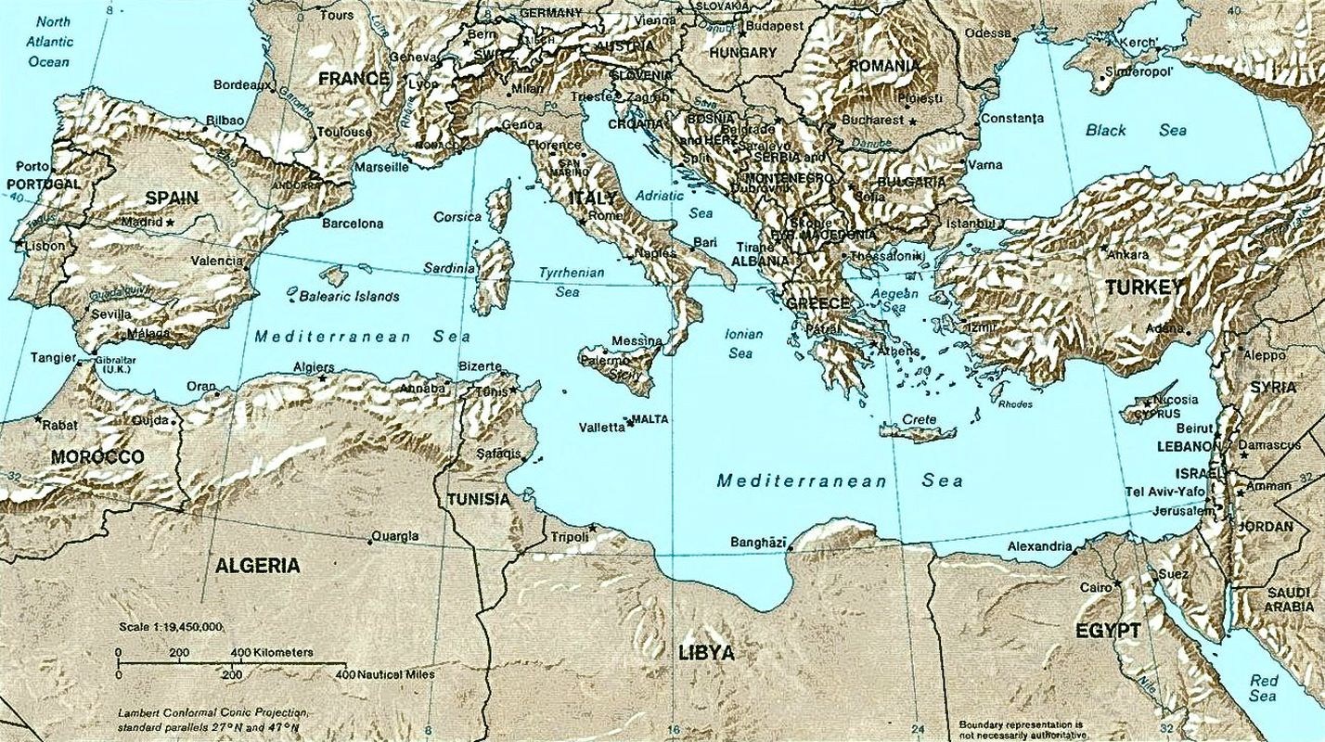
Notes:
Tyre was queen of the sees.
Capitol of Phoenicia.
Most powerful city-state in the empire
False gods
Controlling trade
http://www.bethinking.org/is-christianity-true/is-fulfilled-prophecy-of-value-for-scholarly-apologetics

Slide 19
  Ezekiel’s prophecy about Tyre (Ezekiel 26:1-21)
  Tyre was the capitol of the Phoenician Empire
    Continuously occupied for 2,000 years
      “Impregnable”
      “Queen of the Seas”
Notes:
Tyre was queen of the sees. Capitol of Phonecia

Slide 20
  Ezekiel’s prophecy about Tyre (Ezekiel 26:1-21)
“Therefore thus says the Lord God: ‘Behold, I am against you, O Tyre, and will cause many nations to come up against you, as the sea causes its waves to come up. ⁴And they shall destroy the walls of Tyre and break down her towers; I will also scrape her dust from her, and make her like the top of a rock. ⁵It shall be a place for spreading nets in the midst of the sea, for I have spoken,’ says the Lord God; ‘it shall become plunder for the nations. ⁶Also her daughter villages which are in the fields shall be slain by the sword. Then they shall know that I am the Lord.’
Notes:
http://www.bethinking.org/is-christianity-true/is-fulfilled-prophecy-of-value-for-scholarly-apologetics

Slide 21
  Ezekiel’s prophecy about Tyre (Ezekiel 26:1-21)
“Therefore thus says the Lord God: ‘Behold, I am against you, O Tyre, and will cause many nations to come up against you, as the sea causes its waves to come up. ⁴And they shall destroy the walls of Tyre and break down her towers; I will also scrape her dust from her, and make her like the top of a rock. ⁵It shall be a place for spreading nets in the midst of the sea, for I have spoken,’ says the Lord God; ‘it shall become plunder for the nations. ⁶Also her daughter villages which are in the fields shall be slain by the sword. Then they shall know that I am the Lord.’
Notes:
http://www.bethinking.org/is-christianity-true/is-fulfilled-prophecy-of-value-for-scholarly-apologetics

Slide 22
  Ezekiel’s prophecy about Tyre (Ezekiel 26:1-21)
“Therefore thus says the Lord God: ‘Behold, I am against you, O Tyre, and will cause many nations to come up against you, as the sea causes its waves to come up. ⁴And they shall destroy the walls of Tyre and break down her towers; I will also scrape her dust from her, and make her like the top of a rock. ⁵It shall be a place for spreading nets in the midst of the sea, for I have spoken,’ says the Lord God; ‘it shall become plunder for the nations. ⁶Also her daughter villages which are in the fields shall be slain by the sword. Then they shall know that I am the Lord.’
Notes:
http://www.bethinking.org/is-christianity-true/is-fulfilled-prophecy-of-value-for-scholarly-apologetics

Slide 23
  Ezekiel’s prophecy about Tyre (Ezekiel 26:1-21)
“Therefore thus says the Lord God: ‘Behold, I am against you, O Tyre, and will cause many nations to come up against you, as the sea causes its waves to come up. ⁴And they shall destroy the walls of Tyre and break down her towers; I will also scrape her dust from her, and make her like the top of a rock. ⁵It shall be a place for spreading nets in the midst of the sea, for I have spoken,’ says the Lord God; ‘it shall become plunder for the nations. ⁶Also her daughter villages which are in the fields shall be slain by the sword. Then they shall know that I am the Lord.’
Notes:
http://www.bethinking.org/is-christianity-true/is-fulfilled-prophecy-of-value-for-scholarly-apologetics
Overview of prophecy 1-6

Slide 24
  Ezekiel’s prophecy about Tyre (Ezekiel 26:1-21)
“Therefore thus says the Lord God: ‘Behold, I am against you, O Tyre, and will cause many nations to come up against you, as the sea causes its waves to come up. ⁴And they shall destroy the walls of Tyre and break down her towers; I will also scrape her dust from her, and make her like the top of a rock. ⁵It shall be a place for spreading nets in the midst of the sea, for I have spoken,’ says the Lord God; ‘it shall become plunder for the nations. ⁶Also her daughter villages which are in the fields shall be slain by the sword. Then they shall know that I am the Lord.’
Notes:
http://www.bethinking.org/is-christianity-true/is-fulfilled-prophecy-of-value-for-scholarly-apologetics

Slide 25
  Ezekiel’s prophecy about Tyre (Ezekiel 26:1-21)
⁷“For thus says the Lord God: ‘Behold, I will bring against Tyre from the north Nebuchadnezzar king of Babylon, king of kings, with horses, with chariots, and with horsemen, and an army with many people. ⁸He will slay with the sword your daughter villages in the fields; he will heap up a siege mound against you, build a wall against you, and raise a defense against you. ⁹He will direct his battering rams against your walls, and with his axes he will break down your towers.
Notes:
7-11 specifically what Nebby will do

Slide 26
  Ezekiel’s prophecy about Tyre (Ezekiel 26:1-21)
¹⁰Because of the abundance of his horses, their dust will cover you; your walls will shake at the noise of the horsemen, the wagons, and the chariots, when he enters your gates, as men enter a city that has been breached.
¹¹With the hooves of his horses he will trample all your streets; he will slay your people by the sword, and your strong pillars will fall to the ground.

Slide 27
  Ezekiel’s prophecy about Tyre (Ezekiel 26:1-21)
¹²They will plunder your riches and pillage your merchandise; they will break down your walls and destroy your pleasant houses; they will lay your stones, your timber, and your soil in the midst of the water.
¹³I will put an end to the sound of your songs, and the sound of your harps shall be heard no more.
¹⁴I will make you like the top of a rock; you shall be a place for spreading nets, and you shall never be rebuilt, for I the LORD have spoken,’ says the Lord GOD.
Notes:
12-14 – what other nations (plural) will do

Slide 28
  Requirements of this prophecy

Slide 29
  Requirements of this prophecy
    Many nations will come against Tyre

Slide 30
  Requirements of this prophecy
    Many nations will come against Tyre
    Like the waves of the sea (in sets)

Slide 31
  Requirements of this prophecy
    Many nations will come against Tyre
    Like the waves of the sea (in sets)
    Daughter villages slain by the sword

Slide 32
  Requirements of this prophecy
    Many nations will come against Tyre
    Like the waves of the sea (in sets)
    Daughter villages slain by the sword
    Destruction of the walls and towers of Tyre

Slide 33
  Requirements of this prophecy
    Many nations will come against Tyre
    Like the waves of the sea (in sets)
    Daughter villages slain by the sword
    Destruction of the walls and towers of Tyre
    Nebuchadnezzar will breach the town

Slide 34
  Requirements of this prophecy
    Many nations will come against Tyre
    Like the waves of the sea (in sets)
    Daughter villages slain by the sword
    Destruction of the walls and towers of Tyre
    Nebuchadnezzar will breach the town
    The city will be cast into the sea

Slide 35
  Requirements of this prophecy
    Many nations will come against Tyre
    Like the waves of the sea (in sets)
    Daughter villages slain by the sword
    Destruction of the walls and towers of Tyre
    Nebuchadnezzar will breach the town
    The city will be cast into the sea
    It will be like the top of a rock

Slide 36
  Requirements of this prophecy
    Many nations will come against Tyre
    Like the waves of the sea (in sets)
    Daughter villages slain by the sword
    Destruction of the walls and towers of Tyre
    Nebuchadnezzar will breach the town
    The city will be cast into the sea
    It will be like the top of a rock
    Fishermen will cast there nets there

Slide 37
  Requirements of this prophecy
    Many nations will come against Tyre
    Like the waves of the sea (in sets)
    Daughter villages slain by the sword
    Destruction of the walls and towers of Tyre
    Nebuchadnezzar will breach the town
    The city will be cast into the sea
    It will be like the top of a rock
    Fishermen will cast there nets there
    This city will never be rebuilt

Slide 38
Many nations will come against Tyre

Slide 39
Many nations will come against Tyre
  Tyre had been occupied for 2,000 years!

Slide 40
Many nations will come against Tyre
  Tyre had been occupied for 2,000 years!
Like the waves of the sea (in sets)

Slide 41
Many nations will come against Tyre
  Tyre had been occupied for 2,000 years!
Like the waves of the sea (in sets)
  Different times

Slide 42
Many nations will come against Tyre
  Tyre had been occupied for 2,000 years!
Like the waves of the sea (in sets)
  Different times
Daughter villages slain by the sword

Slide 43
Many nations will come against Tyre
  Tyre had been occupied for 2,000 years!
Like the waves of the sea (in sets)
  Different times
Daughter villages slain by the sword
Destruction of the walls and towers of Tyre

Slide 44
Many nations will come against Tyre
  Tyre had been occupied for 2,000 years!
Like the waves of the sea (in sets)
  Different times
Daughter villages slain by the sword
Destruction of the walls and towers of Tyre
Nebuchadnezzar will breach the town

Slide 45
Many nations will come against Tyre
  Tyre had been occupied for 2,000 years!
Like the waves of the sea (in sets)
  Different times
Daughter villages slain by the sword
Destruction of the walls and towers of Tyre
Nebuchadnezzar will breach the town
  Nebby sieged Tyre for 13 years (586BC)

Slide 46
Many nations will come against Tyre
  Tyre had been occupied for 2,000 years!
Like the waves of the sea (in sets)
  Different times
Daughter villages slain by the sword
Destruction of the walls and towers of Tyre
Nebuchadnezzar will breach the town
  Nebby sieged Tyre for 13 years (586BC)
  The people of Tyre retreated to an Island ½ mile off the coast

Slide 47
    The city will be cast into the sea

Slide 48
    The city will be cast into the sea
    It will be like the top of a rock

Slide 49
    The city will be cast into the sea
    It will be like the top of a rock
      Alexander the Great (332 BC)

Slide 50
    The city will be cast into the sea
    It will be like the top of a rock
      Alexander the Great (332 BC)
      They retreated again

Slide 51
    The city will be cast into the sea
    It will be like the top of a rock
      Alexander the Great (332 BC)
      They retreated again
        He built a causeway

Slide 52
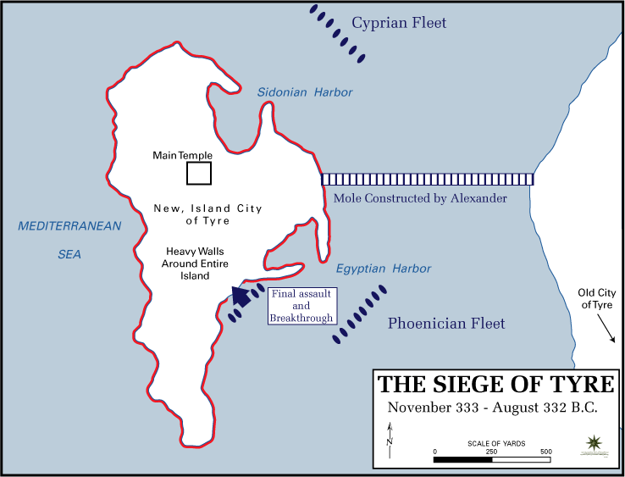

Slide 53
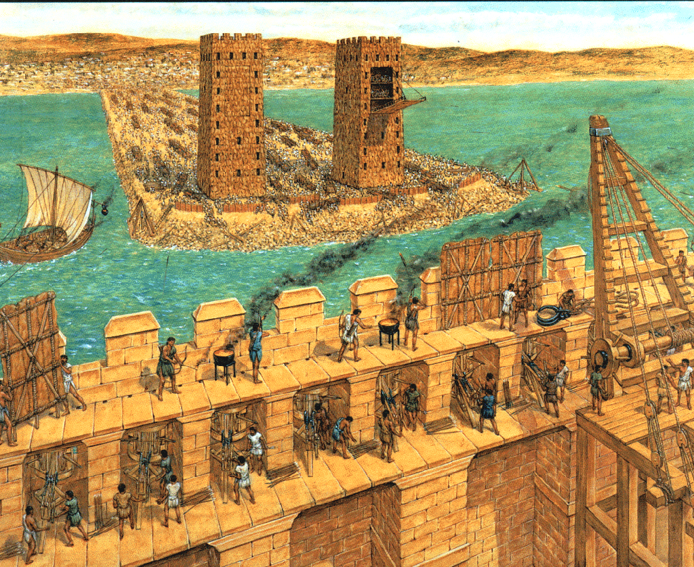

Slide 54
    The city will be cast into the sea
    It will be like the top of a rock
      Alexander the Great (332 BC)
      They retreated again
        He built a causeway
    Fishermen will cast there nets there

Slide 55
    The city will be cast into the sea
    It will be like the top of a rock
      Alexander the Great (332 BC)
      They retreated again
        He built a causeway
    Fishermen will cast there nets there
      The only thing that has constantly happened there is fishing

Slide 56
    Tyre will “never be rebuilt” Ezekiel 26:12
Notes:
1st definition - Swanson, J. (1997). Dictionary of Biblical Languages with Semantic Domains : Hebrew (Old Testament) (electronic ed.). Oak Harbor: Logos Research Systems, Inc.
1- context – the mainland city cast into the ocean and not rebuilt
2- It’s impossible to rebuild what is cast into the ocean
3- Historically, when a new city arose near the old one they called it “new tyre” and said they could see “old tyre” under the water nearby”
4- Tyre NEVER had it’s place restored as the most prominent city in the region or as controlling trade through the Mediterranean

Slide 57
    Tyre will “never be rebuilt” Ezekiel 26:12
      Rebuilt: “be restored, return to a prior existing state”
Notes:
1st definition - Swanson, J. (1997). Dictionary of Biblical Languages with Semantic Domains : Hebrew (Old Testament) (electronic ed.). Oak Harbor: Logos Research Systems, Inc.
1- context – the mainland city cast into the ocean and not rebuilt
2- It’s impossible to rebuild what is cast into the ocean
3- Historically, when a new city arose near the old one they called it “new tyre” and said they could see “old tyre” under the water nearby”
4- Tyre NEVER had it’s place restored as the most prominent city in the region or as controlling trade through the Mediterranean

Slide 58
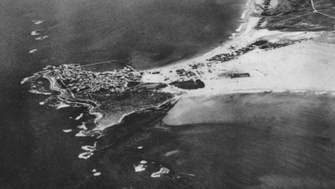
Notes:
Tyre in 1930

Slide 59
    Tyre will “never be rebuilt” Ezekiel 26:12
      Rebuilt: “be restored, return to a prior existing state”
      Modern day Tyre???
Notes:
1st definition - Swanson, J. (1997). Dictionary of Biblical Languages with Semantic Domains : Hebrew (Old Testament) (electronic ed.). Oak Harbor: Logos Research Systems, Inc.
1- context – the mainland city cast into the ocean and not rebuilt
2- It’s impossible to rebuild what is cast into the ocean
3- Historically, when a new city arose near the old one they called it “new tyre” and said they could see “old tyre” under the water nearby”
4- Tyre NEVER had it’s place restored as the most prominent city in the region or as controlling trade through the Mediterranean

Slide 60
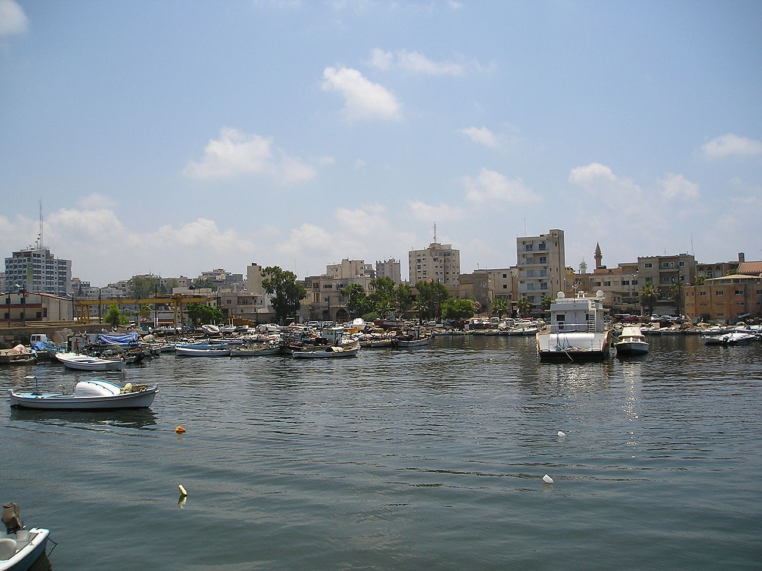

Slide 61
    Tyre will “never be rebuilt” Ezekiel 26:12
      Rebuilt: “be restored, return to a prior existing state”
      Modern day Tyre???
      Can’t rebuild what is under water
Notes:
1st definition - Swanson, J. (1997). Dictionary of Biblical Languages with Semantic Domains : Hebrew (Old Testament) (electronic ed.). Oak Harbor: Logos Research Systems, Inc.
1- context – the mainland city cast into the ocean and not rebuilt
2- It’s impossible to rebuild what is cast into the ocean
3- Historically, when a new city arose near the old one they called it “new tyre” and said they could see “old tyre” under the water nearby”
4- Tyre NEVER had it’s place restored as the most prominent city in the region or as controlling trade through the Mediterranean

Slide 62
    Tyre will “never be rebuilt” Ezekiel 26:12
      Rebuilt: “be restored, return to a prior existing state”
      Modern day Tyre???
      Can’t rebuild what is under water
      Historical sources indicate “New Tyre” “Old Tyre” distinction
Notes:
1st definition - Swanson, J. (1997). Dictionary of Biblical Languages with Semantic Domains : Hebrew (Old Testament) (electronic ed.). Oak Harbor: Logos Research Systems, Inc.
1- context – the mainland city cast into the ocean and not rebuilt
2- It’s impossible to rebuild what is cast into the ocean
3- Historically, when a new city arose near the old one they called it “new tyre” and said they could see “old tyre” under the water nearby”
4- Tyre NEVER had it’s place restored as the most prominent city in the region or as controlling trade through the Mediterranean

Slide 63
    Tyre will “never be rebuilt” Ezekiel 26:12
      Rebuilt: “be restored, return to a prior existing state”
      Modern day Tyre???
      Can’t rebuild what is under water
      Historical sources indicate “New Tyre” “Old Tyre” distinction
      We can’t call any “New Tyre” a “rebuilt Tyre” for two reasons
Notes:
1st definition - Swanson, J. (1997). Dictionary of Biblical Languages with Semantic Domains : Hebrew (Old Testament) (electronic ed.). Oak Harbor: Logos Research Systems, Inc.
1- context – the mainland city cast into the ocean and not rebuilt
2- It’s impossible to rebuild what is cast into the ocean
3- Historically, when a new city arose near the old one they called it “new tyre” and said they could see “old tyre” under the water nearby”
4- Tyre NEVER had it’s place restored as the most prominent city in the region or as controlling trade through the Mediterranean

Slide 64
    Tyre will “never be rebuilt” Ezekiel 26:12
      Rebuilt: “be restored, return to a prior existing state”
      Modern day Tyre???
      Can’t rebuild what is under water
      Historical sources indicate “New Tyre” “Old Tyre” distinction
      We can’t call any “New Tyre” a “rebuilt Tyre” for two reasons
        1: No “old parts” were used
Notes:
1st definition - Swanson, J. (1997). Dictionary of Biblical Languages with Semantic Domains : Hebrew (Old Testament) (electronic ed.). Oak Harbor: Logos Research Systems, Inc.
1- context – the mainland city cast into the ocean and not rebuilt
2- It’s impossible to rebuild what is cast into the ocean
3- Historically, when a new city arose near the old one they called it “new tyre” and said they could see “old tyre” under the water nearby”
4- Tyre NEVER had it’s place restored as the most prominent city in the region or as controlling trade through the Mediterranean

Slide 65
    Tyre will “never be rebuilt” Ezekiel 26:12
      Rebuilt: “be restored, return to a prior existing state”
      Modern day Tyre???
      Can’t rebuild what is under water
      Historical sources indicate “New Tyre” “Old Tyre” distinction
      We can’t call any “New Tyre” a “rebuilt Tyre” for two reasons
        1: No “old parts” were used
        2: No resemblance to the old city
Notes:
1st definition - Swanson, J. (1997). Dictionary of Biblical Languages with Semantic Domains : Hebrew (Old Testament) (electronic ed.). Oak Harbor: Logos Research Systems, Inc.
1- context – the mainland city cast into the ocean and not rebuilt
2- It’s impossible to rebuild what is cast into the ocean
3- Historically, when a new city arose near the old one they called it “new tyre” and said they could see “old tyre” under the water nearby”
4- Tyre NEVER had it’s place restored as the most prominent city in the region or as controlling trade through the Mediterranean

Slide 66
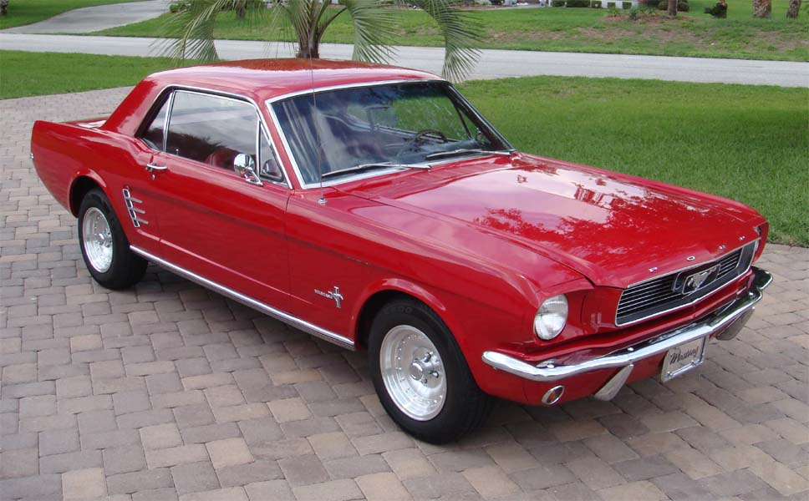
Notes:
1966 mustang

Slide 67
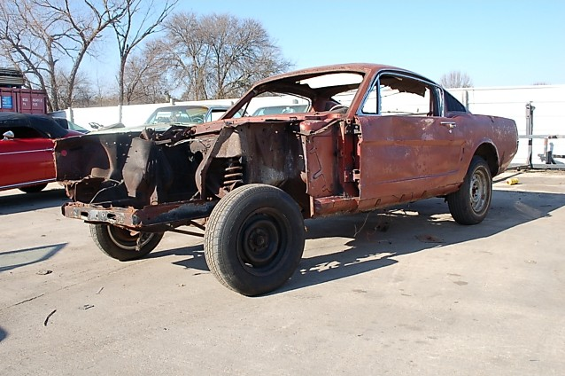
Notes:
But this is even with old parts

Slide 68
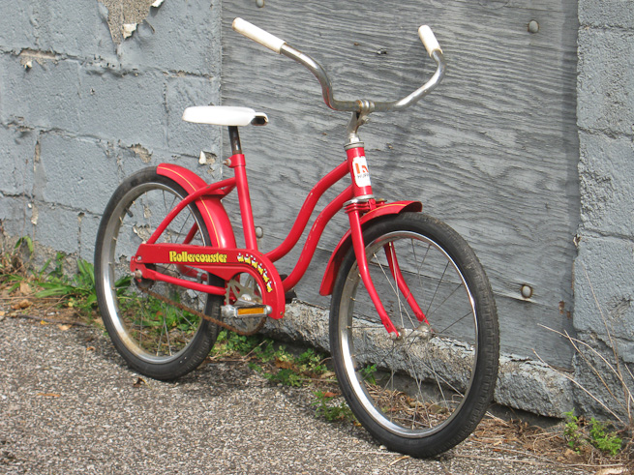
Notes:
No resemblance AND no old parts

Slide 69
Tyre will “never be rebuilt” Ezekiel 26:12
  Rebuilt: “be restored, return to a prior existing state”
  Modern day Tyre???
  Can’t rebuild what is under water
  Historical sources indicate “New Tyre” “Old Tyre” distinction
  We can’t call any “New Tyre” a “rebuilt Tyre” for two reasons
    1: No “old parts” were used
    2: No resemblance to the old city
      Never the most prominent city
Notes:
1st definition - Swanson, J. (1997). Dictionary of Biblical Languages with Semantic Domains : Hebrew (Old Testament) (electronic ed.). Oak Harbor: Logos Research Systems, Inc.
1- context – the mainland city cast into the ocean and not rebuilt
2- It’s impossible to rebuild what is cast into the ocean
3- Historically, when a new city arose near the old one they called it “new tyre” and said they could see “old tyre” under the water nearby”
4- Tyre NEVER had it’s place restored as the most prominent city in the region or as controlling trade through the Mediterranean

Slide 70
Tyre will “never be rebuilt” Ezekiel 26:12
  Rebuilt: “be restored, return to a prior existing state”
  Modern day Tyre???
  Can’t rebuild what is under water
  Historical sources indicate “New Tyre” “Old Tyre” distinction
  We can’t call any “New Tyre” a “rebuilt Tyre” for two reasons
    1: No “old parts” were used
    2: No resemblance to the old city
      Never the most prominent city
      Never controlled trade in Mediterranean
Notes:
1st definition - Swanson, J. (1997). Dictionary of Biblical Languages with Semantic Domains : Hebrew (Old Testament) (electronic ed.). Oak Harbor: Logos Research Systems, Inc.
1- context – the mainland city cast into the ocean and not rebuilt
2- It’s impossible to rebuild what is cast into the ocean
3- Historically, when a new city arose near the old one they called it “new tyre” and said they could see “old tyre” under the water nearby”
4- Tyre NEVER had it’s place restored as the most prominent city in the region or as controlling trade through the Mediterranean

Slide 71
Tyre will “never be rebuilt” Ezekiel 26:12
  Rebuilt: “be restored, return to a prior existing state”
  Modern day Tyre???
  Can’t rebuild what is under water
  Historical sources indicate “New Tyre” “Old Tyre” distinction
  We can’t call any “New Tyre” a “rebuilt Tyre” for two reasons
    1: No “old parts” were used
    2: No resemblance to the old city
      Never the most prominent city
      Never controlled trade in Mediterranean
      Never “Queen of the Seas” or “Impregnable City”
Notes:
1st definition - Swanson, J. (1997). Dictionary of Biblical Languages with Semantic Domains : Hebrew (Old Testament) (electronic ed.). Oak Harbor: Logos Research Systems, Inc.
1- context – the mainland city cast into the ocean and not rebuilt
2- It’s impossible to rebuild what is cast into the ocean
3- Historically, when a new city arose near the old one they called it “new tyre” and said they could see “old tyre” under the water nearby”
4- Tyre NEVER had it’s place restored as the most prominent city in the region or as controlling trade through the Mediterranean

Slide 72
One historian wrote,
"Alexander did far more against Tyre than Shalmaneser or Nebuchadnezzar had done. Not content with crushing her, he took care that she never should revive; for he founded Alexandria as her substitute, and changed forever the track of the commerce of the world.“
(Edward Creasy, Fifteen Decisive Battles of the World, ch. 4).

Slide 73
There most rational conclusion is

Slide 74
There most rational conclusion is
  The Bible is God’s word

Slide 75
There most rational conclusion is
  The Bible is God’s word
    Which also means

Slide 76
There most rational conclusion is
  The Bible is God’s word
    Which also means
      There is a God

Slide 77
Let’s not study prophecy and miss the point!

Slide 78
  It proves that the message is from God
  It guarantees the rest of God’s promises
  It prepares us for the future
  It sets the Bible apart from all other religious books/religions

Slide 79
Psalm 12:6–7 (NKJV)
⁶The words of the Lord are pure words, Like silver tried in a furnace of earth, Purified seven times.
⁷You shall keep them, O Lord, You shall preserve them from this generation forever.
Notes:
Trust the Bible
God loves you
Sin is sin

Slide 80
Psalm 12:6–7 (NKJV)
⁶The words of the Lord are pure words, Like silver tried in a furnace of earth, Purified seven times.
⁷You shall keep them, O Lord, You shall preserve them from this generation forever.
So, trust the Bible
Notes:
Trust the Bible
God loves you
Sin is sin

Slide 81
Psalm 12:6–7 (NKJV)
⁶The words of the Lord are pure words, Like silver tried in a furnace of earth, Purified seven times.
⁷You shall keep them, O Lord, You shall preserve them from this generation forever.
So, trust the Bible
  Not parts of the Bible
Notes:
Trust the Bible
God loves you
Sin is sin

Slide 82
  It proves that the message is from God
  It guarantees the rest of God’s promises
  It prepares us for the future
  It sets the Bible apart from all other religious books/religions

Slide 83
Isaiah 46:11b (NKJV)
Indeed I have spoken it; I will also bring it to pass. I have purposed it; I will also do it.

Slide 84
Isaiah 46:11b (NKJV)
Indeed I have spoken it; I will also bring it to pass. I have purposed it; I will also do it.
Revelation 22:6 (NKJV)
Then he said to me, “These words are faithful and true.” And the Lord God of the holy prophets sent His angel to show His servants the things which must shortly take place.

Slide 85
  The purpose of knowing the signs of what’s to come is not for us to guess at the future details

Slide 86
  The purpose of knowing the signs of what’s to come is not for us to guess at the future details
    It can be fun

Slide 87
  The purpose of knowing the signs of what’s to come is not for us to guess at the future details
    It can be fun
    It can be foolish

Slide 88
  The purpose of knowing the signs of what’s to come is not for us to guess at the future details
    It can be fun
    It can be foolish
    It is to be ready!

Slide 89
  The purpose of knowing the signs of what’s to come is not for us to guess at the future details
    It can be fun
    It can be foolish
    It is to be ready!
    It is to not be troubled

Slide 90
  The purpose of knowing the signs of what’s to come is not for us to guess at the future details
    It can be fun
    It can be foolish
    It is to be ready!
    It is to not be troubled
Matthew 24:6 (NKJV) ⁶And you will hear of wars and rumors of wars. See that you are not troubled; for all these things must come to pass, but the end is not yet.

Slide 91
  It proves that the message is from God
  It guarantees the rest of God’s promises
  It prepares us for the future
  It sets the Bible apart from all other religious books/religions

Slide 92
  Don’t other religious writings have similar prophecies?
    Not even close

Slide 93
  Gives us the comfort of God’s sovereignty
  It helps us make sense of what’s going on in the world around us
  It gives us understanding about the life and sacrifice of the Lord, Jesus Christ

Slide 94
Ephesians 1:11 (NKJV)
¹¹In Him also we have obtained an inheritance, being predestined according to the purpose of Him who works all things according to the counsel of His will,

Slide 95
Habakkuk 3:17–18 (NKJV)
¹⁷Though the fig tree may not blossom, Nor fruit be on the vines; Though the labor of the olive may fail, And the fields yield no food; Though the flock may be cut off from the fold, And there be no herd in the stalls—
¹⁸Yet I will rejoice in the Lord, I will joy in the God of my salvation.

Slide 96
  Gives us the comfort of God’s sovereignty
  It helps us make sense of what’s going on in the world around us
  It gives us understanding about the life and sacrifice of the Lord, Jesus Christ

Slide 97
2 Timothy 3:1 (NKJV)
¹But know this, that in the last days perilous times will come:
Notes:
False teachers
False religions
False Christs
Dangerous trends

Slide 98
  Gives us the comfort of God’s sovereignty
  It helps us make sense of what’s going on in the world around us
  It gives us understanding about the life and sacrifice of the Lord, Jesus Christ

Slide 99
Revelation 19:10b (NKJV)
“For the testimony of Jesus is the spirit of prophecy.”
Notes:
Gospel truths are in prophecy – Ps 22, Is 9, 53, Gen 22,
Comfort
Wisdom
You may not know it all, but, be a student of prophecy!
a student of prophecy is a student of Jesus!

Slide 100
Revelation 19:10b (NKJV)
“For the testimony of Jesus is the spirit of prophecy.”
  a student of prophecy is a student of Jesus!
Notes:
Gospel truths are in prophecy – Ps 22, Is 9, 53, Gen 22,
Comfort
Wisdom
You may not know it all, but, be a student of prophecy!
a student of prophecy is a student of Jesus!

