Slide 1
?

Slide 2
?
  Has God Spoken?

Slide 3
Prophecy

Slide 4
  Two weeks ago – False prophecies

Slide 5
  Two weeks ago – False prophecies
  Last week – Ezekiel 26 the destruction of Tyre

Slide 6
  Two weeks ago – False prophecies
  Last week – Ezekiel 26 the destruction of Tyre
  This week – Prophecy in Daniel

Slide 7
  Daniel 7:1-6, 15-18
¹In the first year of Belshazzar king of Babylon, Daniel had a dream and visions of his head while on his bed. Then he wrote down the dream, telling the main facts.
²Daniel spoke, saying, “I saw in my vision by night, and behold, the four winds of heaven were stirring up the Great Sea.
³And four great beasts came up from the sea, each different from the other.
Notes:
We are interested in these four beasts

Slide 8
  Daniel 7:1-6, 15-18
⁴The first was like a lion, and had eagle’s wings. I watched till its wings were plucked off; and it was lifted up from the earth and made to stand on two feet like a man, and a man’s heart was given to it.
⁵“And suddenly another beast, a second, like a bear. It was raised up on one side, and had three ribs in its mouth between its teeth. And they said thus to it: ‘Arise, devour much flesh!’
⁶“After this I looked, and there was another, like a leopard, which had on its back four wings of a bird. The beast also had four heads, and dominion was given to it.

Slide 9
  Daniel 7:1-6, 15-18
¹⁵“I, Daniel, was grieved in my spirit within my body, and the visions of my head troubled me.
¹⁶I came near to one of those who stood by, and asked him the truth of all this. So he told me and made known to me the interpretation of these things:
¹⁷‘Those great beasts, which are four, are four kings which arise out of the earth.
¹⁸But the saints of the Most High shall receive the kingdom, and possess the kingdom forever, even forever and ever.’

Slide 10
  Daniel 7:1-6, 15-18
¹⁵“I, Daniel, was grieved in my spirit within my body, and the visions of my head troubled me.
¹⁶I came near to one of those who stood by, and asked him the truth of all this. So he told me and made known to me the interpretation of these things:
¹⁷‘Those great beasts, which are four, are four kings which arise out of the earth.
¹⁸But the saints of the Most High shall receive the kingdom, and possess the kingdom forever, even forever and ever.’

Slide 11
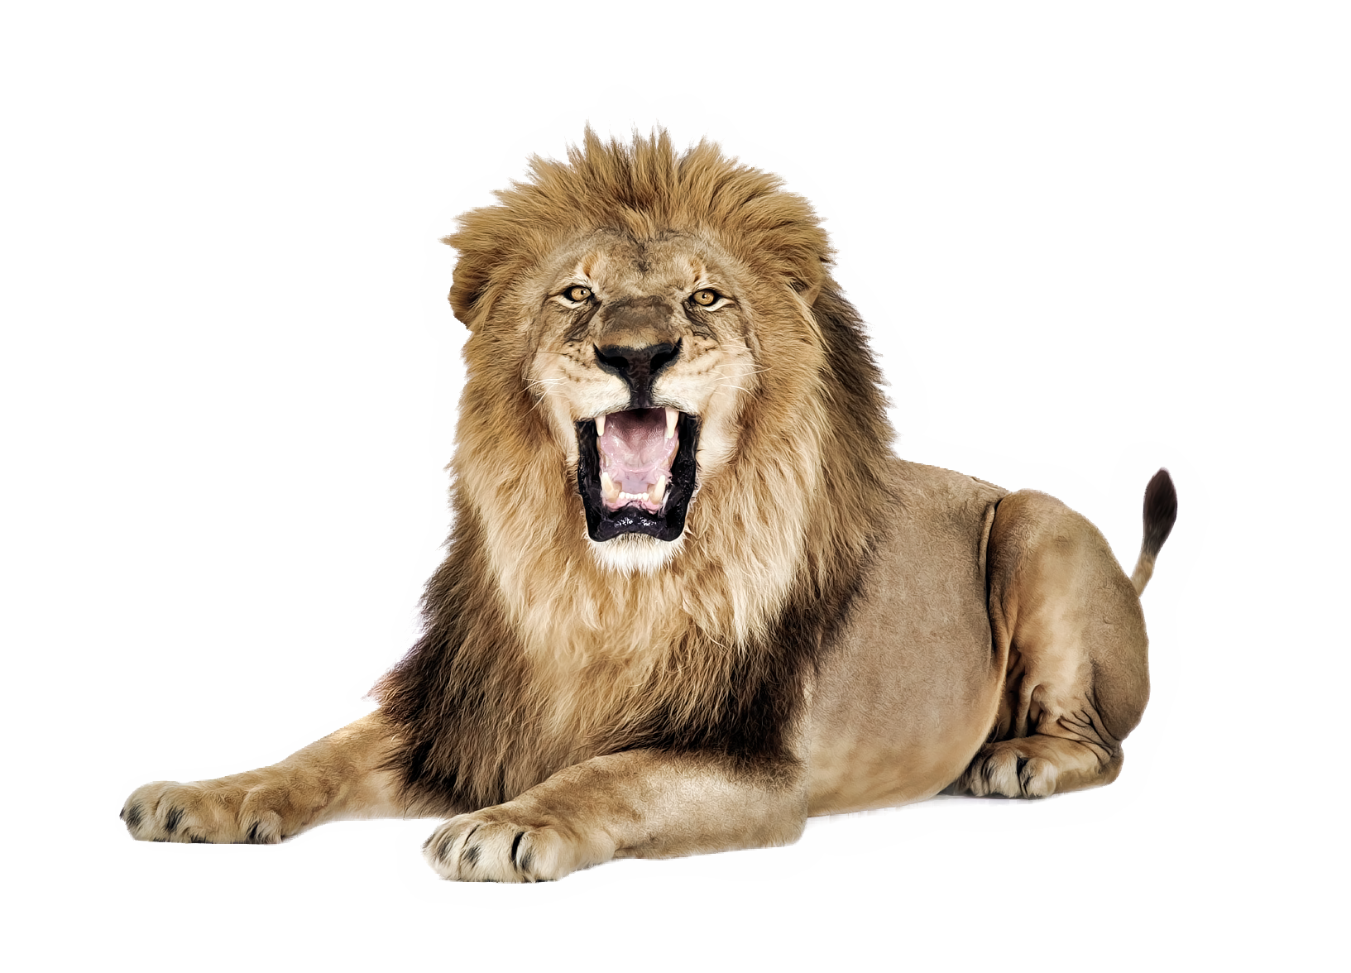
The First Beast
  Like a lion

Slide 12
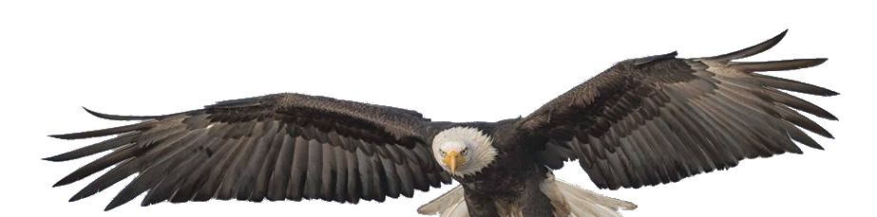
The First Beast
  Like a lion
  With eagle’s wings

Slide 13
The First Beast
  Like a lion
  With eagle’s wings
  Wings plucked

Slide 14

The First Beast
  Like a lion
  With eagle’s wings
  Wings plucked
  Made to stand like man

Slide 15

The First Beast
  Like a lion
  With eagle’s wings
  Wings plucked
  Made to stand like man
  Given a man’s heart
Notes:
Could also be translated “mind”

Slide 16
The First Beast
  Lion = Nebuchadnezzar/Babylon
  Referred to as a lion in Jer 4:7 and Ezek 17:3

Slide 17
The First Beast
  Lion = Nebuchadnezzar/Babylon
  Referred to as a lion in Jer 4:7 and Ezek 17:3
  Lions in Babylonian art

Slide 18
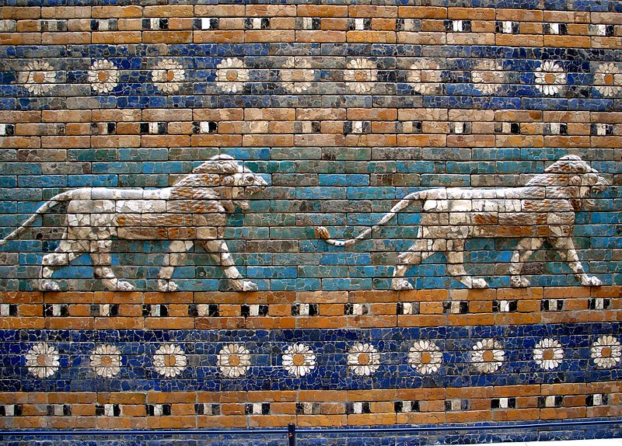
The Ishtar Gate
Notes:
Built by Nebby
This and the walls
Lions were found on his palace walls as well

Slide 19
The First Beast
  Lion = Nebuchadnezzar/Babylon
  Wings = majesty and dominance
Notes:
King of beasts – king of birds

Slide 20
The First Beast
  Lion = Nebuchadnezzar/Babylon
  Wings = majesty and dominance
  Wings plucked

Slide 21
The First Beast
  Lion = Nebuchadnezzar/Babylon
  Wings = majesty and dominance
  Wings plucked
  Made to stand like man

Slide 22
The First Beast
  Lion = Nebuchadnezzar/Babylon
  Wings = majesty and dominance
  Wings plucked
  Made to stand like man
  Given a man’s heart
Notes:
Could also be translated “mind”

Slide 23
The First Beast
  Lion = Nebuchadnezzar/Babylon
  Wings = majesty and dominance
  Wings plucked
  Made to stand like man
  Given a man’s heart
    Dan 4
Notes:
Could also be translated “mind”
Nebby’s descent into madness 7 years

Slide 24
The First Beast
  That’s NOT prophecy!!!
Notes:
1st year of king Belshazzar

Slide 25
The First Beast
  That’s NOT prophecy!!!
  It IS a pattern of interpretation to follow as we look at the other beasts
Notes:
This, among other things, keeps us from interpreting it any way we want

Slide 26
The Second Beast
Notes:
This, among other things, keeps us from interpreting it any way we want

Slide 27

The Second Beast
  Bear
Notes:
This, among other things, keeps us from interpreting it any way we want

Slide 28
The Second Beast
  Bear = Medo-Persian Empire (539-331BC)
Notes:
Bear – lumbering, taking what it wants

Slide 29
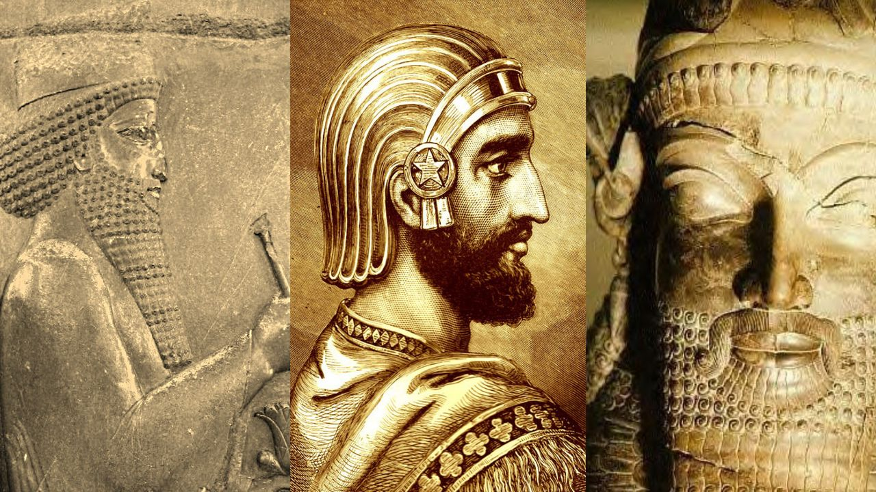
Cyrus The Great
Notes:
Founded Persian Empire – started as a client state of the Medes

Slide 30
The Second Beast
  Bear = Medo-Persian Empire (539-331BC)
  Raised up = Persians
Notes:
Media was the overlord of Persia until Cyrus
Cyrus took over and the Persians slowly rose to power
In 546 he took the capitol of Media (who had been in power over Persia) and 3 years later changed his title to King of Persia

Slide 31
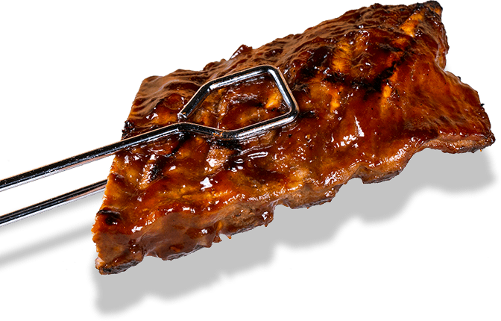
The Second Beast
  Bear = Medo-Persian Empire (539-331BC)
  Raised up = Persians
  Three ribs in it’s mouth
Notes:
This, among other things, keeps us from interpreting it any way we want

Slide 32
The Second Beast
  Bear = Medo-Persian Empire (539-331BC)
  Raised up = Persians
  Three ribs in it’s mouth
  Babylon, Lydia, and Egypt
Notes:
These three had treaties with the previous king of Media but had war with Cyrus

Slide 33
The Second Beast
  Bear = Medo-Persian Empire (539-331BC)
  Raised up = Persians
  Three ribs in it’s mouth
  Babylon, Lydia, and Egypt
  “arise, devour
  much flesh”
Notes:
Arise! – you are the next ruler!

Slide 34

The Third Beast
  Leopard
Notes:
~ swift
Alex was born in 356
Alexander conquered the entire empire between 334 and 330BC
~ powerful and has dominion
~ you’re next
~ everywhere he went they just surrendered
~ dominion is given!

Slide 35
The Third Beast
  Leopard = Alexander the Great (336-323BC)
Notes:
~ swift
Alex was born in 356
Alexander conquered the entire empire between 334 and 330BC
~ powerful and has dominion
~ you’re next
~ everywhere he went they just surrendered
~ dominion is given!

Slide 36
The Third Beast
  Leopard = Alexander the Great (336-323BC)
  Four wings = speed
Notes:
~ swift
Alex was born in 356
Alexander conquered the entire empire between 334 and 330BC
~ powerful and has dominion
~ you’re next
~ everywhere he went they just surrendered
~ dominion is given!

Slide 37
The Third Beast
  Leopard = Alexander the Great (336-323BC)
  Four wings = speed
  Four heads = 4 Generals
Notes:
~ swift
Alex was born in 356
Alexander conquered the entire empire between 334 and 330BC
~ powerful and has dominion
~ you’re next
~ everywhere he went they just surrendered
~ dominion is given!

Slide 38
The Third Beast
  Leopard = Alexander the Great (336-323BC)
  Four wings = speed
  Four heads = 4 Generals
  Dominion
Notes:
~ swift
Alex was born in 356
Alexander conquered the entire empire between 334 and 330BC
~ powerful and has dominion
~ you’re next
~ everywhere he went they just surrendered
~ dominion is given!

Slide 39
The Fourth Beast
  Future prophecy

Slide 40
Daniel’s Second Vision
Daniel 8:1–8 (NKJV)
¹In the third year of the reign of King Belshazzar a vision appeared to me—to me, Daniel—after the one that appeared to me the first time.
²I saw in the vision, and it so happened while I was looking, that I was in Shushan, the citadel, which is in the province of Elam; and I saw in the vision that I was by the River Ulai.
Notes:
~ swift
Alexander conquered the entire empire between 334 and 330BC
~ powerful and has dominion
~ everywhere he went they just surrendered

Slide 41
Daniel’s Second Vision
³Then I lifted my eyes and saw, and there, standing beside the river, was a ram which had two horns, and the two horns were high; but one was higher than the other, and the higher one came up last.
⁴I saw the ram pushing westward, northward, and southward, so that no animal could withstand him; nor was there any that could deliver from his hand, but he did according to his will and became great.
Notes:
~ swift
Alexander conquered the entire empire between 334 and 330BC
~ powerful and has dominion
~ everywhere he went they just surrendered

Slide 42
Daniel’s Second Vision
The Interpretation:
²⁰The ram which you saw, having the two horns—they are the kings of Media and Persia.
Notes:
Ram –
Media was already large at the time of this prophecy and was in process of joining with Persia (c550 BC – third year of King Belshazzar)
Persia was relatively small
Before Cyrus came to power, Media already was a major force, while Persia was a small country holding less than fifty thousand square miles of territory.﻿﻿ But Cyrus succeeded in gaining control of powerful Media to the north (ca. 550 B.C.) and then made Persia the more important of the two states. With these nations united, he established the vast Medo-Persian Empire. (New American Commentary: Daniel)

Slide 43
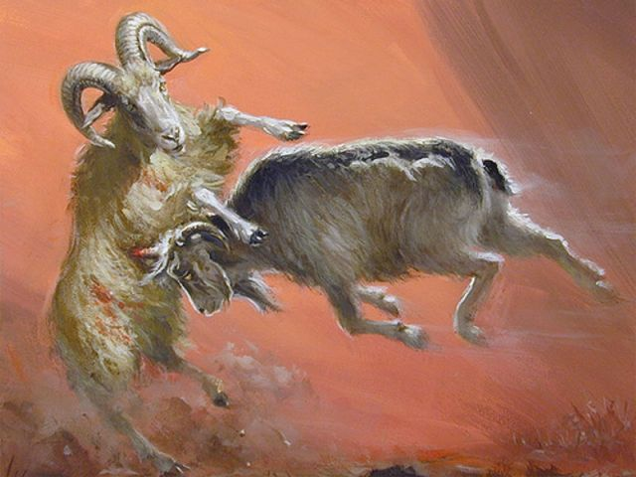
Daniel’s Second Vision
Ram
Notes:
Ram – Persia was affiliated with the Zodiac sign “Aries” the Ram.
Media was already large at the time of this prophecy and was in process of joining with Persia (c550 BC – third year of King Belshazzar)
Persia was relatively small
Before Cyrus came to power, Media already was a major force, while Persia was a small country holding less than fifty thousand square miles of territory.﻿﻿ But Cyrus succeeded in gaining control of powerful Media to the north (ca. 550 B.C.) and then made Persia the more important of the two states. With these nations united, he established the vast Medo-Persian Empire. (New American Commentary: Daniel)

Slide 44
Daniel’s Second Vision
Ram – Medo-Persians (539-330BC)
Notes:
Ram – Persia was affiliated with the Zodiac sign “Aries” the Ram.
Media was already large at the time of this prophecy and was in process of joining with Persia (c550 BC – third year of King Belshazzar)
Persia was relatively small
Before Cyrus came to power, Media already was a major force, while Persia was a small country holding less than fifty thousand square miles of territory.﻿﻿ But Cyrus succeeded in gaining control of powerful Media to the north (ca. 550 B.C.) and then made Persia the more important of the two states. With these nations united, he established the vast Medo-Persian Empire. (New American Commentary: Daniel)

Slide 45
Daniel’s Second Vision
Ram – Medo-Persians (539-330BC)
Two horns – Media and Persia
Notes:
Ram – Persia was affiliated with the Zodiac sign “Aries” the Ram.
Media was already large at the time of this prophecy and was in process of joining with Persia (c550 BC – third year of King Belshazzar)
Persia was relatively small
Before Cyrus came to power, Media already was a major force, while Persia was a small country holding less than fifty thousand square miles of territory.﻿﻿ But Cyrus succeeded in gaining control of powerful Media to the north (ca. 550 B.C.) and then made Persia the more important of the two states. With these nations united, he established the vast Medo-Persian Empire. (New American Commentary: Daniel)

Slide 46
Daniel’s Second Vision
Ram – Medo-Persians (539-330BC)
Two horns – Media and Persia
One came up last - Persia
Notes:
Ram – Persia was affiliated with the Zodiac sign “Aries” the Ram.
Media was already large at the time of this prophecy and was in process of joining with Persia (c550 BC – third year of King Belshazzar)
Persia was relatively small
Before Cyrus came to power, Media already was a major force, while Persia was a small country holding less than fifty thousand square miles of territory.﻿﻿ But Cyrus succeeded in gaining control of powerful Media to the north (ca. 550 B.C.) and then made Persia the more important of the two states. With these nations united, he established the vast Medo-Persian Empire. (New American Commentary: Daniel)

Slide 47
Daniel’s Second Vision
Ram – Medo-Persians (539-330BC)
Two horns – Media and Persia
One came up last - Persia
But it was higher – In prestige
Notes:
Ram – Persia was affiliated with the Zodiac sign “Aries” the Ram.
Media was already large at the time of this prophecy and was in process of joining with Persia (c550 BC – third year of King Belshazzar)
Persia was relatively small
Before Cyrus came to power, Media already was a major force, while Persia was a small country holding less than fifty thousand square miles of territory.﻿﻿ But Cyrus succeeded in gaining control of powerful Media to the north (ca. 550 B.C.) and then made Persia the more important of the two states. With these nations united, he established the vast Medo-Persian Empire. (New American Commentary: Daniel)

Slide 48
Daniel’s Second Vision
⁵And as I was considering, suddenly a male goat came from the west, across the surface of the whole earth, without touching the ground; and the goat had a notable horn between his eyes.
⁶Then he came to the ram that had two horns, which I had seen standing beside the river, and ran at him with furious power.
Notes:
~ swift
Alexander conquered the entire empire between 334 and 330BC
~ powerful and has dominion
~ everywhere he went they just surrendered

Slide 49
Daniel’s Second Vision
⁷And I saw him confronting the ram; he was moved with rage against him, attacked the ram, and broke his two horns. There was no power in the ram to withstand him, but he cast him down to the ground and trampled him; and there was no one that could deliver the ram from his hand.
⁸Therefore the male goat grew very great; but when he became strong, the large horn was broken, and in place of it four notable ones came up toward the four winds of heaven.
Notes:
~ swift
Alexander conquered the entire empire between 334 and 330BC
~ powerful and has dominion
~ everywhere he went they just surrendered

Slide 50
Daniel’s Second Vision
Interpretation:
²¹And the male goat is the kingdom of Greece. The large horn that is between its eyes is the first king.
²²As for the broken horn and the four that stood up in its place, four kingdoms shall arise out of that nation, but not with its power.
Notes:
~ swift
Alexander conquered the entire empire between 334 and 330BC
~ powerful and has dominion
~ everywhere he went they just surrendered

Slide 51
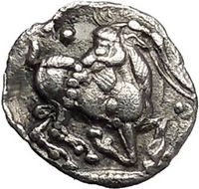
Daniel’s Second Vision
Goat – Greeks (336-___BC)
Notes:
Alexander was Macedonian – they were symbolized by goats
Alexander’s son was named Alexander Aegus – son of the goat
The first Macedonian king was said to be aided by goats

Slide 52
Daniel’s Second Vision
Goat – Greeks (336-___BC)
One horn – Alexander The Great
Notes:
Alexander (1st King)

Slide 53
Daniel’s Second Vision
Goat – Greeks (336-___BC)
One horn – Alexander The Great
Flying from the west
Notes:
From the west – with GREAT speed!
a leopard with 4 wings
Alexander would march for days chasing his enemies and keeping them from being able to prepare

Slide 54
Daniel’s Second Vision
Goat – Greeks (336-___BC)
One horn – Alexander The Great
Flying from the west
Ran right over the ram
Notes:
3 years to conquer so much – they just surrendered
No long battle, no generational wars

Slide 55
Daniel’s Second Vision
Goat – Greeks (336-___BC)
One horn – Alexander The Great
Flying from the west
Ran right over the ram
When he got strong, broken
Notes:
age of 32 Malaria June 13th 323 BC– with plans to invade Rome, and Carthage.
“who do you leave your kingdom to?”
“the strong”

Slide 56
Daniel’s Second Vision
Goat – Greeks (336-___BC)
One horn – Alexander The Great
Flying from the west
Ran right over the ram
When he got strong, broken
Four notable horns came up
Notes:
Four horns – four heads
Four generals

Slide 57
“To The Strong”
Notes:
~ swift
Alexander conquered the entire empire between 334 and 330BC
~ powerful and has dominion
~ everywhere he went they just surrendered
“to the strong”
4 Generals
Cassander got Macedonia and Greece
Lysimachus got Thrace, Bithynia and most of Asia Minor
Seleucus got Syria and the area east of Syria, including Babylon
Ptolemy got Egypt and probably Palestine and Arabia Petrea.

Slide 58
“To The Strong”
4 Generals:
Notes:
~ swift
Alexander conquered the entire empire between 334 and 330BC
~ powerful and has dominion
~ everywhere he went they just surrendered
“to the strong”
4 Generals
Cassander got Macedonia and Greece
Lysimachus got Thrace, Bithynia and most of Asia Minor
Seleucus got Syria and the area east of Syria, including Babylon
Ptolemy got Egypt and probably Palestine and Arabia Petrea.

Slide 59
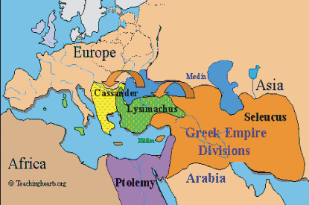
“To The Strong”
4 Generals:
Notes:
~ swift
Alexander conquered the entire empire between 334 and 330BC
~ powerful and has dominion
~ everywhere he went they just surrendered
“to the strong”
4 Generals
Cassander got Macedonia and Greece
Lysimachus got Thrace, Bithynia and most of Asia Minor
Seleucus got Syria and the area east of Syria, including Babylon
Ptolemy got Egypt and probably Palestine and Arabia Petrea.

Slide 60
“To The Strong”
4 Generals:
Cassander
Notes:
~ swift
Alexander conquered the entire empire between 334 and 330BC
~ powerful and has dominion
~ everywhere he went they just surrendered
“to the strong”
4 Generals
Cassander got Macedonia and Greece
Lysimachus got Thrace, Bithynia and most of Asia Minor
Seleucus got Syria and the area east of Syria, including Babylon
Ptolemy got Egypt and probably Palestine and Arabia Petrea.

Slide 61
“To The Strong”
4 Generals:
Cassander
Lysimachus
Notes:
~ swift
Alexander conquered the entire empire between 334 and 330BC
~ powerful and has dominion
~ everywhere he went they just surrendered
“to the strong”
4 Generals
Cassander got Macedonia and Greece
Lysimachus got Thrace, Bithynia and most of Asia Minor
Seleucus got Syria and the area east of Syria, including Babylon
Ptolemy got Egypt and probably Palestine and Arabia Petrea.

Slide 62
“To The Strong”
4 Generals:
Cassander
Lysimachus
Seleucus
Notes:
~ swift
Alexander conquered the entire empire between 334 and 330BC
~ powerful and has dominion
~ everywhere he went they just surrendered
“to the strong”
4 Generals
Cassander got Macedonia and Greece
Lysimachus got Thrace, Bithynia and most of Asia Minor
Seleucus got Syria and the area east of Syria, including Babylon
Ptolemy got Egypt and probably Palestine and Arabia Petrea.

Slide 63
“To The Strong”
4 Generals:
Cassander
Lysimachus
Seleucus
Ptolemy
Notes:
~ swift
Alexander conquered the entire empire between 334 and 330BC
~ powerful and has dominion
~ everywhere he went they just surrendered
“to the strong”
4 Generals
Cassander got Macedonia and Greece
Lysimachus got Thrace, Bithynia and most of Asia Minor
Seleucus got Syria and the area east of Syria, including Babylon
Ptolemy got Egypt and probably Palestine and Arabia Petrea.

Slide 64
Daniel’s Second Vision
Daniel 8:9–14 (NKJV)
⁹And out of one of them came a little horn which grew exceedingly great toward the south, toward the east, and toward the Glorious Land.
¹⁰And it grew up to the host of heaven; and it cast down some of the host and some of the stars to the ground, and trampled them.
¹¹He even exalted himself as high as the Prince of the host; and by him the daily sacrifices were taken away, and the place of His sanctuary was cast down.
Notes:
Now the vision focuses in on one man!
South, east, Glorious land
- Glorious land - Israel
The Seleucid empire is, in Daniel, seen as the King of the North
Host of heaven – trampled them
See vs24 and 12:3

Slide 65
Daniel’s Second Vision
Daniel 8:9–14 (NKJV) ¹²Because of transgression, an army was given over to the horn to oppose the daily sacrifices; and he cast truth down to the ground. He did all this and prospered. ¹³Then I heard a holy one speaking; and another holy one said to that certain one who was speaking, “How long will the vision be, concerning the daily sacrifices and the transgression of desolation, the giving of both the sanctuary and the host to be trampled underfoot?” ¹⁴And he said to me, “For two thousand three hundred days; then the sanctuary shall be cleansed.”

Slide 66
Daniel’s Second Vision
Daniel 8:23–26 (NKJV)
²³“And in the latter time of their kingdom, When the transgressors have reached their fullness, A king shall arise, Having fierce features, Who understands sinister schemes.
²⁴His power shall be mighty, but not by his own power; He shall destroy fearfully, And shall prosper and thrive; He shall destroy the mighty, and also the holy people.

Slide 67
Daniel’s Second Vision
Daniel 8:23–26 (NKJV)
²⁵“Through his cunning He shall cause deceit to prosper under his rule; And he shall exalt himself in his heart. He shall destroy many in their prosperity. He shall even rise against the Prince of princes; But he shall be broken without human means.
²⁶“And the vision of the evenings and mornings Which was told is true; Therefore seal up the vision, For it refers to many days in the future.”

Slide 68
Antiochus IV (Epiphanes) c.215-164BC
Notes:
~ swift
Alexander conquered the entire empire between 334 and 330BC
~ powerful and has dominion
~ everywhere he went they just surrendered
“to the strong”
4 Generals
Cassander got Macedonia and Greece
Lysimahus got Thrace, Bithynia and most of Asia Minor
Seleucus got Syria and the area east of Syria, including Babylon
Ptolemy got Egypt and probably Palestine and Arabia Petrea.

Slide 69
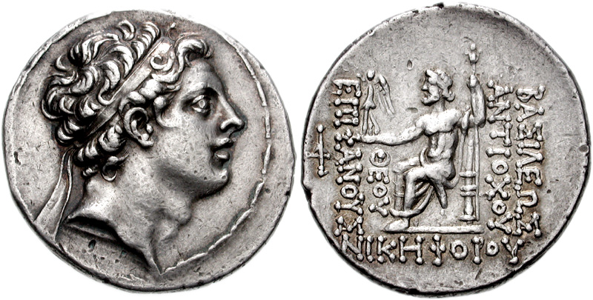
Antiochus IV (Epiphanes) c.215-164BC
Seleucid king (175-164BC)
Notes:
~ swift
Alexander conquered the entire empire between 334 and 330BC
~ powerful and has dominion
~ everywhere he went they just surrendered
“to the strong”
4 Generals
Cassander got Macedonia and Greece
Lysimahus got Thrace, Bithynia and most of Asia Minor
Seleucus got Syria and the area east of Syria, including Babylon
Ptolemy got Egypt and probably Palestine and Arabia Petrea.

Slide 70
Antiochus IV (Epiphanes) c.215-164BC
Seleucid king (175-164BC)
  Arose from the Seleucid “horn”
Notes:
~ swift
Alexander conquered the entire empire between 334 and 330BC
~ powerful and has dominion
~ everywhere he went they just surrendered
“to the strong”
4 Generals
Cassander got Macedonia and Greece
Lysimahus got Thrace, Bithynia and most of Asia Minor
Seleucus got Syria and the area east of Syria, including Babylon
Ptolemy got Egypt and probably Palestine and Arabia Petrea.

Slide 71
Antiochus IV (Epiphanes) c.215-164BC
Seleucid king (175-164BC)
  Arose from the Seleucid “horn”
⁹And out of one of them came a little horn which grew exceedingly great toward the south, toward the east, and toward the Glorious Land.
Notes:
From the North!
South – Eqypt – finally, the seleucids were able to successfully invade Egypt and plunder it
East –
Glorious land – Israel – especially in prophecy
What he did NOT threaten was Rome in the west

Slide 72
Antiochus IV (Epiphanes) c.215-164BC
Seleucid king (175-164BC)
  Arose from the Seleucid “horn”
  Little horn
⁹And out of one of them came a little horn which grew exceedingly great toward the south, toward the east, and toward the Glorious Land.
Notes:
Came from smaller stature to a place of great power
wasn’t supposed to be the king
He made notable conquests in “the south” (Egypt), “the east” (Persia, Parthia, Armenia)
Miller, S. R. (1994). Vol. 18: Daniel. The New American Commentary (225). Nashville: Broadman & Holman Publishers.

Slide 73
Antiochus IV (Epiphanes) c.215-164BC
Seleucid king (175-164BC)
  Arose from the Seleucid “horn”
  Little horn
  He gains power through schemes
^{23b}A king shall arise, Having fierce features, Who understands sinister schemes.
²⁴His power shall be mighty, but not by his own power;
Notes:
Antiochus took the throne through schemes
Unlike Cyrus and Alexander
Antiochus was NOT the right ruler of the Seleucids.
was taken as hostage in to Rome for peace with Rome
gained more power
deal maker
Seleucus IV (then king) was assassinated
Demetrius (proper heir) was in Rome
Seleucus' legitimate heir Demetrius I Soter was still a hostage in Rome, so Antiochus seized the throne for himself with the help of King Eumenes II of Pergamum, proclaiming himself co-regent with another son of Seleucus, an infant named Antiochus (whom he then murdered a few years later).^{[9]}

Slide 74
Antiochus IV (Epiphanes) c.215-164BC
Seleucid king (175-164BC)
  Arose from the Seleucid “horn”
  Little horn
  He gains power through schemes
  Toward the end of the Seleucid
  Empire
²³“And in the latter time of their kingdom…
Notes:
After Antiochus’ time their was civil war and the empire declined until it was overtaken by the Romans
shortly after his death they lost Israel
by 130BC they lost all lands west of the Euphrates
When the Romans took over in 64 they were no longer an empire
NOW, the reason why we he is in this passage is because of his attacks on the Jews.
Antiochus is one of the worst enemies of the Jews to have every lived

Slide 75
Daniel’s Second Vision
Daniel 8:9–14 (NKJV)
⁹And out of one of them came a little horn which grew exceedingly great toward the south, toward the east, and toward the Glorious Land.
¹⁰And it grew up to the host of heaven; and it cast down some of the host and some of the stars to the ground, and trampled them.
¹¹He even exalted himself as high as the Prince of the host; and by him the daily sacrifices were taken away, and the place of His sanctuary was cast down.
Notes:
Host of heaven – trampled them
See vs24 and 12:3

Slide 76
Daniel’s Second Vision
Daniel 8:9–14 (NKJV)
⁹And out of one of them came a little horn which grew exceedingly great toward the south, toward the east, and toward the Glorious Land.
¹⁰And it grew up to the host of heaven; and it cast down some of the host and some of the stars to the ground, and trampled them.
¹¹He even exalted himself as high as the Prince of the host; and by him the daily sacrifices were taken away, and the place of His sanctuary was cast down.
Daniel 8:24
²⁴His power shall be mighty, but not by his own power; He shall destroy fearfully, And shall prosper and thrive; He shall destroy the mighty, and also the holy people.
Notes:
Host of heaven – trampled them
See vs24 and 12:3

Slide 77
Daniel’s Second Vision
Daniel 8:9–14 (NKJV)
⁹And out of one of them came a little horn which grew exceedingly great toward the south, toward the east, and toward the Glorious Land.
¹⁰And it grew up to the host of heaven; and it cast down some of the host and some of the stars to the ground, and trampled them.
¹¹He even exalted himself as high as the Prince of the host; and by him the daily sacrifices were taken away, and the place of His sanctuary was cast down.
Daniel 8:24
²⁴His power shall be mighty, but not by his own power; He shall destroy fearfully, And shall prosper and thrive; He shall destroy the mighty, and also the holy people.
Daniel 12:3
³Those who are wise shall shine Like the brightness of the firmament, And those who turn many to righteousness Like the stars forever and ever.
Notes:
Host of heaven – trampled them
See vs24 and 12:3

Slide 78
Antiochus IV (Epiphanes) c.215-164BC
Notes:
After Antiochus’ time their was civil war and the empire declined until it was overtaken by the Romans
shortly after his death they lost Israel
by 130BC they lost all lands west of the Euphrates
When the Romans took over in 64 they were no longer an empire
NOW, the reason why we he is in this passage is because of his attacks on the Jews.
Antiochus is one of the worst enemies of the Jews to have every lived

Slide 79
Antiochus IV (Epiphanes) c.215-164BC
Persecution of the Jewish people
Notes:
After Antiochus’ time their was civil war and the empire declined until it was overtaken by the Romans
shortly after his death they lost Israel
by 130BC they lost all lands west of the Euphrates
When the Romans took over in 64 they were no longer an empire
NOW, the reason why we he is in this passage is because of his attacks on the Jews.
Antiochus is one of the worst enemies of the Jews to have every lived

Slide 80
Antiochus IV (Epiphanes) c.215-164BC
Persecution of the Jewish people
  No more tolerance
Notes:
After Antiochus’ time their was civil war and the empire declined until it was overtaken by the Romans
shortly after his death they lost Israel
by 130BC they lost all lands west of the Euphrates
When the Romans took over in 64 they were no longer an empire
NOW, the reason why we he is in this passage is because of his attacks on the Jews.
Antiochus is one of the worst enemies of the Jews to have every lived

Slide 81
Antiochus IV (Epiphanes) c.215-164BC
Persecution of the Jewish people
  No more tolerance
  Destroyed copies of the Torah
Notes:
After Antiochus’ time their was civil war and the empire declined until it was overtaken by the Romans
shortly after his death they lost Israel
by 130BC they lost all lands west of the Euphrates
When the Romans took over in 64 they were no longer an empire
NOW, the reason why we he is in this passage is because of his attacks on the Jews.
Antiochus is one of the worst enemies of the Jews to have every lived

Slide 82
Antiochus IV (Epiphanes) c.215-164BC
Persecution of the Jewish people
  No more tolerance
  Destroyed copies of the Torah
  Forbid Torah observance
Notes:
After Antiochus’ time their was civil war and the empire declined until it was overtaken by the Romans
shortly after his death they lost Israel
by 130BC they lost all lands west of the Euphrates
When the Romans took over in 64 they were no longer an empire
NOW, the reason why we he is in this passage is because of his attacks on the Jews.
Antiochus is one of the worst enemies of the Jews to have every lived

Slide 83
Antiochus IV (Epiphanes) c.215-164BC
Persecution of the Jewish people
  No more tolerance
  Destroyed copies of the Torah
  Forbid Torah observance
  Sold High Priest position (twice)
Notes:
After Antiochus’ time their was civil war and the empire declined until it was overtaken by the Romans
shortly after his death they lost Israel
by 130BC they lost all lands west of the Euphrates
When the Romans took over in 64 they were no longer an empire
NOW, the reason why we he is in this passage is because of his attacks on the Jews.
Antiochus is one of the worst enemies of the Jews to have every lived

Slide 84
Antiochus IV (Epiphanes) c.215-164BC
Persecution of the Jewish people
  No more tolerance
  Destroyed copies of the Torah
  Forbid Torah observance
  Sold High Priest position (twice)
  Commanded the Jews to
Notes:
After Antiochus’ time their was civil war and the empire declined until it was overtaken by the Romans
shortly after his death they lost Israel
by 130BC they lost all lands west of the Euphrates
When the Romans took over in 64 they were no longer an empire
NOW, the reason why we he is in this passage is because of his attacks on the Jews.
Antiochus is one of the worst enemies of the Jews to have every lived

Slide 85
Antiochus IV (Epiphanes) c.215-164BC
Persecution of the Jewish people
  No more tolerance
  Destroyed copies of the Torah
  Forbid Torah observance
  Sold High Priest position (twice)
  Commanded the Jews to
    Eat pork
Notes:
After Antiochus’ time their was civil war and the empire declined until it was overtaken by the Romans
shortly after his death they lost Israel
by 130BC they lost all lands west of the Euphrates
When the Romans took over in 64 they were no longer an empire
NOW, the reason why we he is in this passage is because of his attacks on the Jews.
Antiochus is one of the worst enemies of the Jews to have every lived

Slide 86
Antiochus IV (Epiphanes) c.215-164BC
Persecution of the Jewish people
  No more tolerance
  Destroyed copies of the Torah
  Forbid Torah observance
  Sold High Priest position (twice)
  Commanded the Jews to
    Eat pork
    Not circumcise
Notes:
After Antiochus’ time their was civil war and the empire declined until it was overtaken by the Romans
shortly after his death they lost Israel
by 130BC they lost all lands west of the Euphrates
When the Romans took over in 64 they were no longer an empire
NOW, the reason why we he is in this passage is because of his attacks on the Jews.
Antiochus is one of the worst enemies of the Jews to have every lived

Slide 87
Antiochus IV (Epiphanes) c.215-164BC
Persecution of the Jewish people
  No more tolerance
  Destroyed copies of the Torah
  Forbid Torah observance
  Sold High Priest position (twice)
  Commanded the Jews to
    Eat pork
    Not circumcise
    Worship Zeus
Notes:
After Antiochus’ time their was civil war and the empire declined until it was overtaken by the Romans
shortly after his death they lost Israel
by 130BC they lost all lands west of the Euphrates
When the Romans took over in 64 they were no longer an empire
NOW, the reason why we he is in this passage is because of his attacks on the Jews.
Antiochus is one of the worst enemies of the Jews to have every lived

Slide 88
Antiochus IV (Epiphanes) c.215-164BC
Persecution of the Jewish people
  No more tolerance
  Destroyed copies of the Torah
  Forbid Torah observance
  Sold High Priest position (twice)
  Commanded the Jews to
    Eat pork
    Not circumcise
    Worship Zeus
    Or die
Notes:
After Antiochus’ time their was civil war and the empire declined until it was overtaken by the Romans
shortly after his death they lost Israel
by 130BC they lost all lands west of the Euphrates
When the Romans took over in 64 they were no longer an empire
NOW, the reason why we he is in this passage is because of his attacks on the Jews.
Antiochus is one of the worst enemies of the Jews to have every lived

Slide 89
Antiochus IV (Epiphanes) c.215-164BC
Persecution of the Jewish people
  No more tolerance
  Destroyed copies of the Torah
  Forbid Torah observance
  Sold High Priest position (twice)
  Commanded the Jews to
    Eat pork
    Not circumcise
    Worship Zeus
    Or die
  Killed 40,000 in two days
Notes:
After Antiochus’ time their was civil war and the empire declined until it was overtaken by the Romans
shortly after his death they lost Israel
by 130BC they lost all lands west of the Euphrates
When the Romans took over in 64 they were no longer an empire
NOW, the reason why we he is in this passage is because of his attacks on the Jews.
Antiochus is one of the worst enemies of the Jews to have every lived

Slide 90
Antiochus IV (Epiphanes) c.215-164BC
Specific prophecies about the Temple
Notes:
After Antiochus’ time their was civil war and the empire declined until it was overtaken by the Romans
shortly after his death they lost Israel
by 130BC they lost all lands west of the Euphrates
When the Romans took over in 64 they were no longer an empire
NOW, the reason why we he is in this passage is because of his attacks on the Jews.
Antiochus is one of the worst enemies of the Jews to have every lived

Slide 91
Daniel’s Second Vision
Daniel 8:9–14 (NKJV) ¹²Because of transgression, an army was given over to the horn to oppose the daily sacrifices; and he cast truth down to the ground. He did all this and prospered. ¹³Then I heard a holy one speaking; and another holy one said to that certain one who was speaking, “How long will the vision be, concerning the daily sacrifices and the transgression of desolation, the giving of both the sanctuary and the host to be trampled underfoot?” ¹⁴And he said to me, “For two thousand three hundred days; then the sanctuary shall be cleansed.”

Slide 92
Daniel’s Second Vision
Daniel 8:23–26 (NKJV)
²⁵“Through his cunning He shall cause deceit to prosper under his rule; And he shall exalt himself in his heart. He shall destroy many in their prosperity. He shall even rise against the Prince of princes; But he shall be broken without human means.
²⁶“And the vision of the evenings and mornings Which was told is true; Therefore seal up the vision, For it refers to many days in the future.”

Slide 93
Antiochus IV (Epiphanes) c.215-164BC
Specific prophecies about the Temple
  Sold the high priest position
Notes:
After Antiochus’ time their was civil war and the empire declined until it was overtaken by the Romans
shortly after his death they lost Israel
by 130BC they lost all lands west of the Euphrates
When the Romans took over in 64 they were no longer an empire
NOW, the reason why we he is in this passage is because of his attacks on the Jews.
Antiochus is one of the worst enemies of the Jews to have every lived

Slide 94
Antiochus IV (Epiphanes) c.215-164BC
Specific prophecies about the Temple
  Sold the high priest position
  Plundered the Temple
Notes:
After Antiochus’ time their was civil war and the empire declined until it was overtaken by the Romans
shortly after his death they lost Israel
by 130BC they lost all lands west of the Euphrates
When the Romans took over in 64 they were no longer an empire
NOW, the reason why we he is in this passage is because of his attacks on the Jews.
Antiochus is one of the worst enemies of the Jews to have every lived

Slide 95
Antiochus IV (Epiphanes) c.215-164BC
Specific prophecies about the Temple
  Sold the high priest position
  Plundered the Temple
  He STOPPED the daily sacrifices
Notes:
After Antiochus’ time their was civil war and the empire declined until it was overtaken by the Romans
shortly after his death they lost Israel
by 130BC they lost all lands west of the Euphrates
When the Romans took over in 64 they were no longer an empire
NOW, the reason why we he is in this passage is because of his attacks on the Jews.
Antiochus is one of the worst enemies of the Jews to have every lived

Slide 96
Antiochus IV (Epiphanes) c.215-164BC
Specific prophecies about the Temple
  Sold the high priest position
  Plundered the Temple
  He STOPPED the daily sacrifices
  Slaughtered pigs on the Altar
Notes:
After Antiochus’ time their was civil war and the empire declined until it was overtaken by the Romans
shortly after his death they lost Israel
by 130BC they lost all lands west of the Euphrates
When the Romans took over in 64 they were no longer an empire
NOW, the reason why we he is in this passage is because of his attacks on the Jews.
Antiochus is one of the worst enemies of the Jews to have every lived

Slide 97
Antiochus IV (Epiphanes) c.215-164BC
Specific prophecies about the Temple
  Sold the high priest position
  Plundered the Temple
  He STOPPED the daily sacrifices
  Slaughtered pigs on the Altar
  Put an icon of Zeus in
  the Temple
Notes:
After Antiochus’ time their was civil war and the empire declined until it was overtaken by the Romans
shortly after his death they lost Israel
by 130BC they lost all lands west of the Euphrates
When the Romans took over in 64 they were no longer an empire
NOW, the reason why we he is in this passage is because of his attacks on the Jews.
Antiochus is one of the worst enemies of the Jews to have every lived

Slide 98
Antiochus IV (Epiphanes) c.215-164BC
Specific prophecies about the Temple
  Sold the high priest position
  Plundered the Temple
  He STOPPED the daily sacrifices
  Slaughtered pigs on the Altar
  Put an icon of Zeus in
  the Temple
  Had sacrifices to Zeus in
  the Temple
Notes:
After Antiochus’ time their was civil war and the empire declined until it was overtaken by the Romans
shortly after his death they lost Israel
by 130BC they lost all lands west of the Euphrates
When the Romans took over in 64 they were no longer an empire
NOW, the reason why we he is in this passage is because of his attacks on the Jews.
Antiochus is one of the worst enemies of the Jews to have every lived

Slide 99
Antiochus IV (Epiphanes) c.215-164BC
Specific prophecies about the Temple
  Sold the high priest position
  Plundered the Temple
  Slaughtered pigs on the Altar
  Put an icon of Zeus in
  the Temple
  Had sacrifices to Zeus in
  the Temple
Notes:
The coin says King Antiochus, God manifest, bearing victory
Picture – Antiochus on the front, Zeus carrying Nike on the back (goddess of victory)
He put up altars to Zeus in places and declared himself to be one of the incarnations of Zeus
SO…

Slide 100
Daniel’s Second Vision
Daniel 8:23–26 (NKJV)
²⁵“Through his cunning He shall cause deceit to prosper under his rule; And he shall exalt himself in his heart. He shall destroy many in their prosperity. He shall even rise against the Prince of princes; But he shall be broken without human means.
²⁶“And the vision of the evenings and mornings Which was told is true; Therefore seal up the vision, For it refers to many days in the future.”
Notes:
Against GOD – most kings didn’t do this! They were more pluralistic.
Antiochus fits like a glove!!!

Slide 101
Daniel’s Second Vision
Daniel 8:14, 26 (NKJV)
¹⁴And he said to me, “For two thousand three hundred days; then the sanctuary shall be cleansed.”
²⁶“And the vision of the evenings and mornings Which was told is true; Therefore seal up the vision, For it refers to many days in the future.”
Notes:
2,300?
day/year? no
2300 days or Evenings and Mornings
Let’s start with the cleansing
Maccabean Revolt!
December 25th 164BC it was cleansed – Hannakuh

Slide 102
Maccabean Revolt
Notes:
2,300?
Let’s start with the cleansing
Maccabean Revolt!
December 25th 164BC it was cleansed – Hannakuh
What was 2300 days before that? About 6 years and 4 months.
we don’t know
Antiochus 1st incursion into Jerusalem (170BC)
Murder of Onia the High Priest
The ascension of Jason (a false high priest)
The cessation of the sacrifices (unknown date)

Slide 103
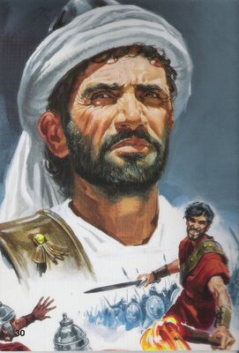
Maccabean Revolt
Judas Maccabeus (Hammer)
Notes:
2,300?
Let’s start with the cleansing
Maccabean Revolt!
December 25th 164BC it was cleansed – Hannakuh
What was 2300 days before that? About 6 years and 4 months.
we don’t know
Antiochus 1st incursion into Jerusalem (170BC)
Murder of Onia the High Priest
The ascension of Jason (a false high priest)
The cessation of the sacrifices (unknown date)

Slide 104
Maccabean Revolt
Judas Maccabeus (Hammer)
Started in 167BC
Notes:
2,300?
Let’s start with the cleansing
Maccabean Revolt!
December 25th 164BC it was cleansed – Hannakuh
What was 2300 days before that? About 6 years and 4 months.
we don’t know
Antiochus 1st incursion into Jerusalem (170BC)
Murder of Onia the High Priest
The ascension of Jason (a false high priest)
The cessation of the sacrifices (unknown date)

Slide 105
Maccabean Revolt
Judas Maccabeus (Hammer)
Started in 167BC
Guerilla warfare
Notes:
2,300?
Let’s start with the cleansing
Maccabean Revolt!
December 25th 164BC it was cleansed – Hannakuh
What was 2300 days before that? About 6 years and 4 months.
we don’t know
Antiochus 1st incursion into Jerusalem (170BC)
Murder of Onia the High Priest
The ascension of Jason (a false high priest)
The cessation of the sacrifices (unknown date)

Slide 106
Maccabean Revolt
Judas Maccabeus (Hammer)
Started in 167BC
Guerilla warfare
Eventually retook Israel and
made it independent
Notes:
2,300?
Let’s start with the cleansing
Maccabean Revolt!
December 25th 164BC it was cleansed – Hannakuh
What was 2300 days before that? About 6 years and 4 months.
we don’t know
Antiochus 1st incursion into Jerusalem (170BC)
Murder of Onia the High Priest
The ascension of Jason (a false high priest)
The cessation of the sacrifices (unknown date)

Slide 107
Maccabean Revolt
Judas Maccabeus (Hammer)
Started in 167BC
Guerilla warfare
Eventually retook Israel and
made it independent
Cleanse the Temple
Dec 25th 164BC
Notes:
2,300?
Let’s start with the cleansing
Maccabean Revolt!
December 25th 164BC it was cleansed – Hannakuh
What was 2300 days before that? About 6 years and 4 months.
we don’t know
Antiochus 1st incursion into Jerusalem (170BC)
Murder of Onia the High Priest
The ascension of Jason (a false high priest)
The cessation of the sacrifices (unknown date)

Slide 108
Daniel’s Second Vision
Daniel 8:23–26 (NKJV)
²⁵“Through his cunning He shall cause deceit to prosper under his rule; And he shall exalt himself in his heart. He shall destroy many in their prosperity. He shall even rise against the Prince of princes; But he shall be broken without human means.
Notes:
Died of illness in 164BC the same year the Temple was cleansed
Antiochus fits like a glove!!!

Slide 109
Daniel’s Second Vision
Daniel 8:23–26 (NKJV)
²⁵“Through his cunning He shall cause deceit to prosper under his rule; And he shall exalt himself in his heart. He shall destroy many in their prosperity. He shall even rise against the Prince of princes; But he shall be broken without human means.
In 164 BC he died
Notes:
Died of illness in 164BC the same year the Temple was cleansed
Antiochus fits like a glove!!!

Slide 110
Daniel’s Second Vision
Daniel 8:23–26 (NKJV)
²⁵“Through his cunning He shall cause deceit to prosper under his rule; And he shall exalt himself in his heart. He shall destroy many in their prosperity. He shall even rise against the Prince of princes; But he shall be broken without human means.
In 164 BC he died
  Not in battle
Notes:
Died of illness in 164BC the same year the Temple was cleansed
Antiochus fits like a glove!!!

Slide 111
Daniel’s Second Vision
Daniel 8:23–26 (NKJV)
²⁵“Through his cunning He shall cause deceit to prosper under his rule; And he shall exalt himself in his heart. He shall destroy many in their prosperity. He shall even rise against the Prince of princes; But he shall be broken without human means.
In 164 BC he died
  Not in battle
  Not assassinated
Notes:
Died of illness in 164BC the same year the Temple was cleansed
Antiochus fits like a glove!!!

Slide 112
Daniel’s Second Vision
Daniel 8:23–26 (NKJV)
²⁵“Through his cunning He shall cause deceit to prosper under his rule; And he shall exalt himself in his heart. He shall destroy many in their prosperity. He shall even rise against the Prince of princes; But he shall be broken without human means.
In 164 BC he died
  Not in battle
  Not assassinated
  Sudden illness
Notes:
Died of illness in 164BC the same year the Temple was cleansed
Antiochus fits like a glove!!!

Slide 113
Daniel 7&8
Correctly predicted
Medo-Persian Kingdom and it’s particulars
Alexander the Great’s conquest and the style of his military victories.
The division of his empire into 4.
The specific reign of Antiochus IV; how he would rise, what he would do, how he would die.
The desecration and cleansing of the Temple.
This is why they attack the DATE of Daniel!
Notes:
NEXT WEEK – Daniel 9 and the dating of Daniel!

